Slide 1



PRISMS Center Center for PRedictive Integrated Structural Materials Science
CASM Tutorial – Section 1
Brian Puchala, John C. Thomas, Anton Van der Ven
Anirudh Natarajan, John Goiri, Min-Hua Chen, Max Radin, Jonathon Bechtel, Elizabeth Decolvenaere, Anna Belak,
Naga Sri Harsha Gunda, Sanjeev Kolli
TMS ICME 2017
Thurs. May 24, 2017
Website: prisms-center.org

Slide 2
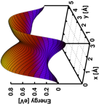
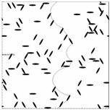
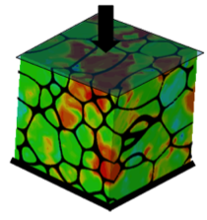
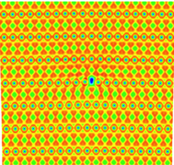
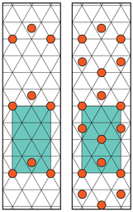
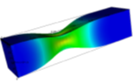
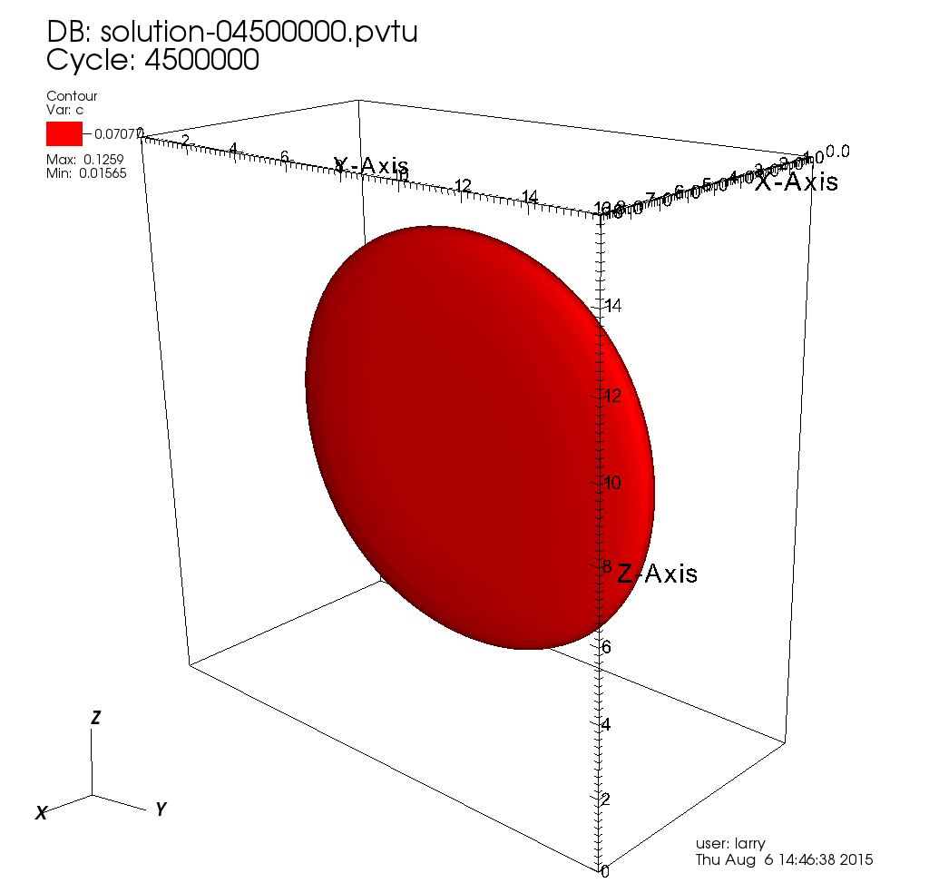
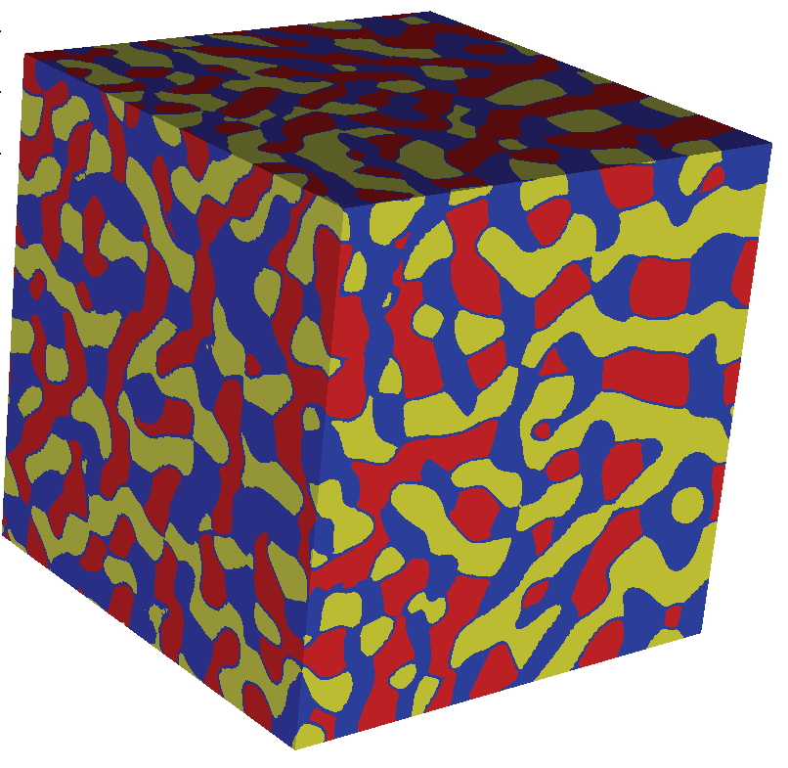

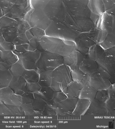
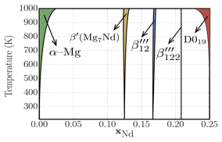

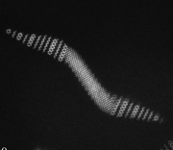
PRISMS Center Integrated Framework
Atomic scale
constitutive laws
Dislocation Dynamics
(LLNL-ParaDIS)
Crystal Plasticity
(PRISMS-Plasticity)
Real Space DFT
(PRISMS-RSDFT)
Statistical Mechanics
(CASM)
Continuum Plasticity
(PRISMS-Plasticity)
Phase Field
(PRISMS-PF)
Mechano-Chemistry
(PRISMS-MC*)
Fourier Space DFT
(VASP)
Phase Diagrams
(CASM/CALPHAD)
Experiments (slip,
twinning, crack, etc.)
Phase Field Crystal
(PRISMS-PFC*)
Experiments

Slide 3
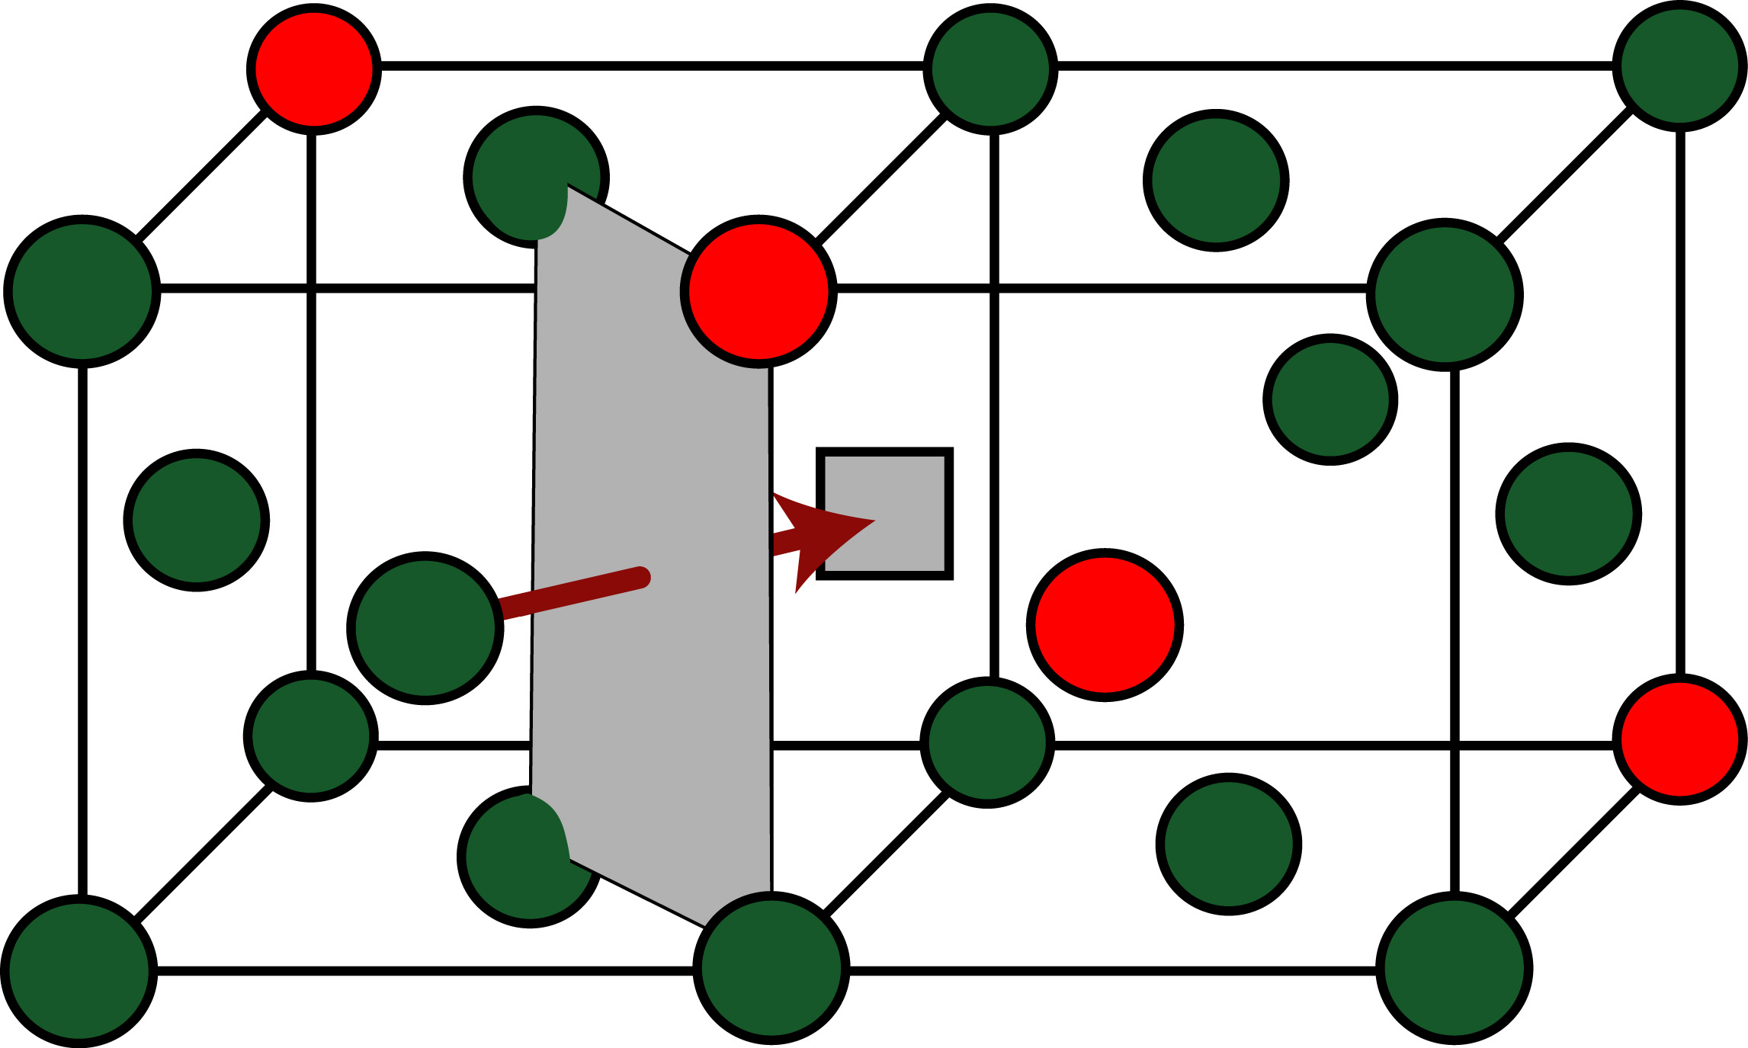
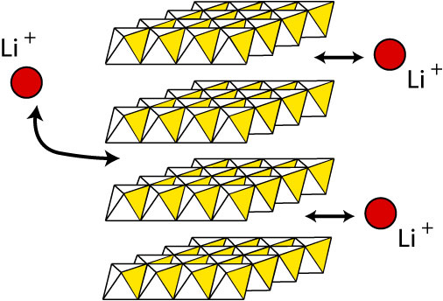
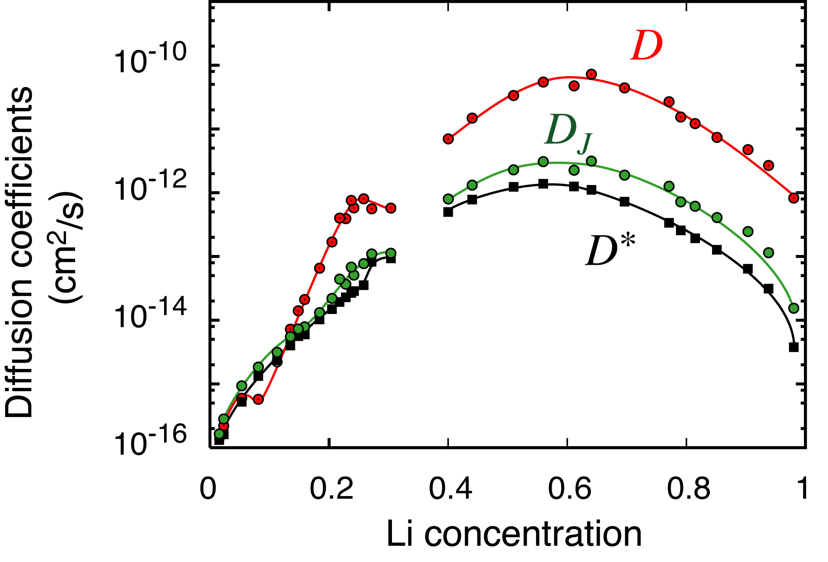
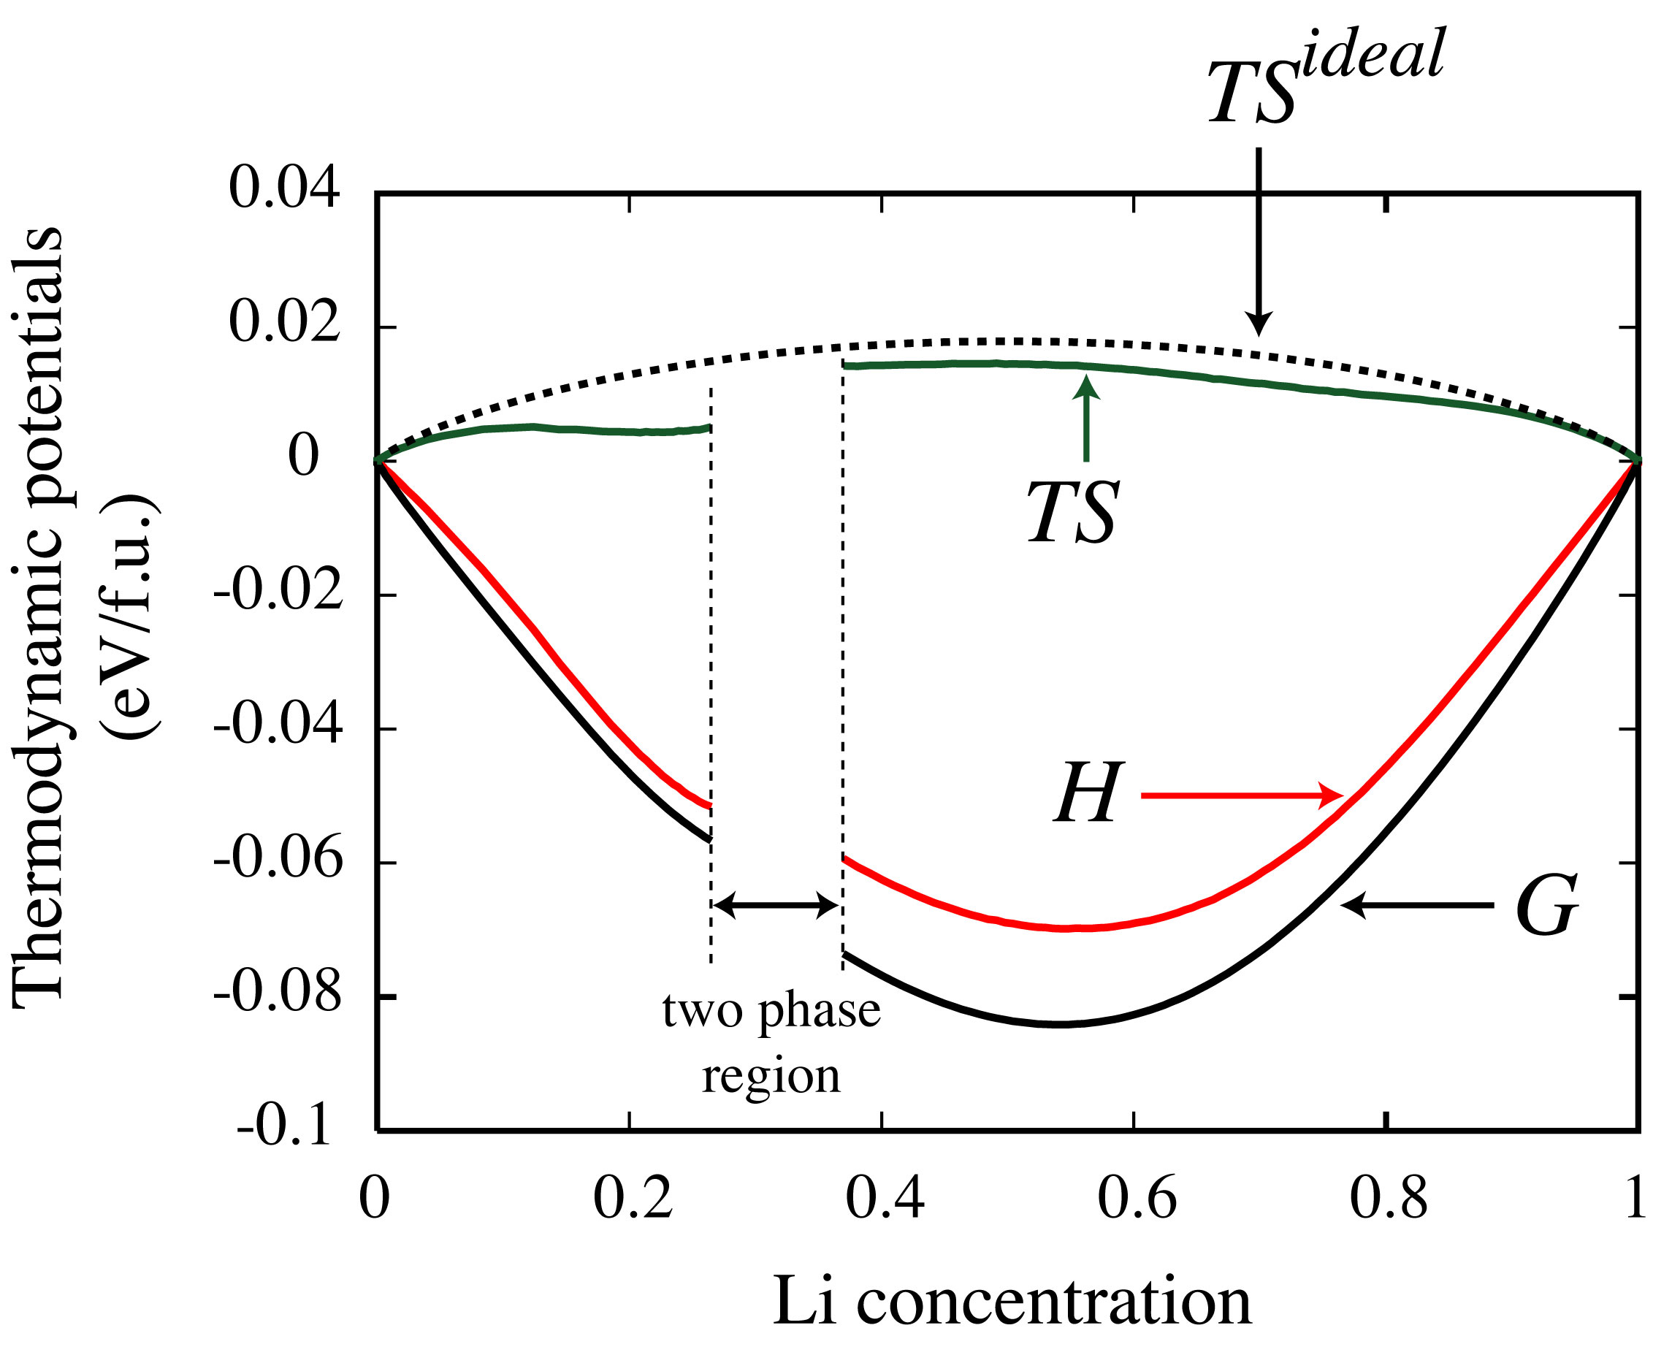
Electronic structure
Linking atomistic descriptions to phenomenological models of materials
Statistical Mechanics
Thermodynamics
Kinetics
Solid Mechanics
Phenomenological
descriptions
Notes:
Many of the most important or useful descriptions of materials behaviour are continuum descriptions.
Phase stability, mechanical properties, and microstructure evolution, can all be understood in terms of the free energy and kinetic coefficients of particular materials.
But of course these quantities fundamentally depend on atomistic interactions.
Our work is focused on using methods of statistical mechanics to link accurate ab initio electronic structure calculations of atomistic systems to phenomenological descriptions of materials.

Slide 4
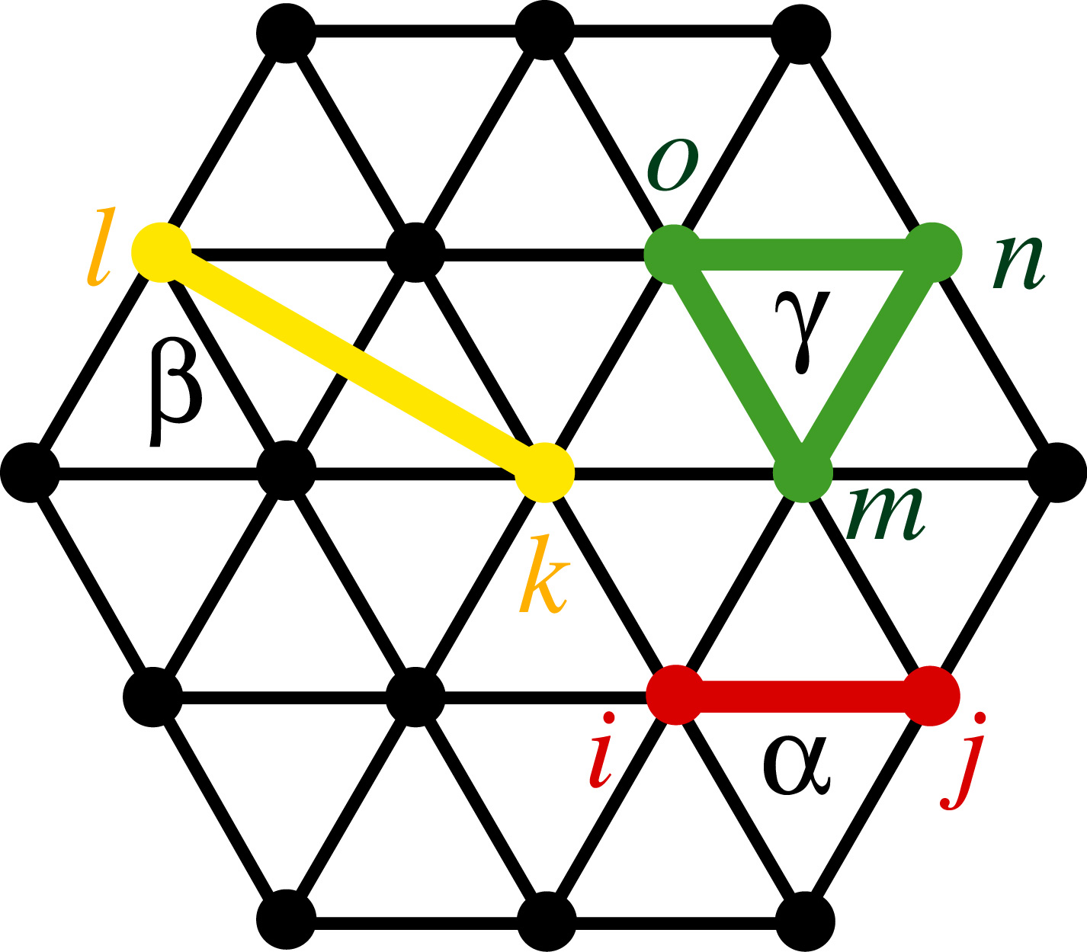
Electronic structure
Via rigorous and arbitrarily extendible cluster expansion Hamiltonians
Cluster Expansion Hamiltonians
Statistical Mechanics
Q₁
Phenomenological
descriptions
Notes:
We do this by constructing cluster expansion effective Hamiltonians in terms of atomic degrees of freedom.
These descriptions are nearly as accurate as electronic structure calculations, but orders of magnitude faster, enabling monte carlo calculations of thermodynamic and kinetic quantities.
The methods we use have many applications, but today I'll just talk about how we've applied it to basic science of the thermodynamics in the Zr-O-H system.

Slide 5
CASM Tutorial Outline
1:30 – 3:00:
Crystal structure identification & specification
Symmetry analysis
Using CASM to manage data
Configuration selections and query syntax
Maintaining sanity with cluster expansion profiles
Cluster expansion basics
Configuration enumeration
Cluster expansion basis sets & correlation evaluation
3:30 – 5:00:
Parameterizing cluster expansions
Predicting thermodynamic properties with grand canonical Monte Carlo
Free energy integration and phase diagram construction

Slide 6
CASM: Clusters Approach to Statistical Mechanics
First-principles energies of a “few” excitations
Extrapolate to
all other excitations
Lattice Model Hamiltonian
Monte Carlo
Thermodynamics

Slide 7
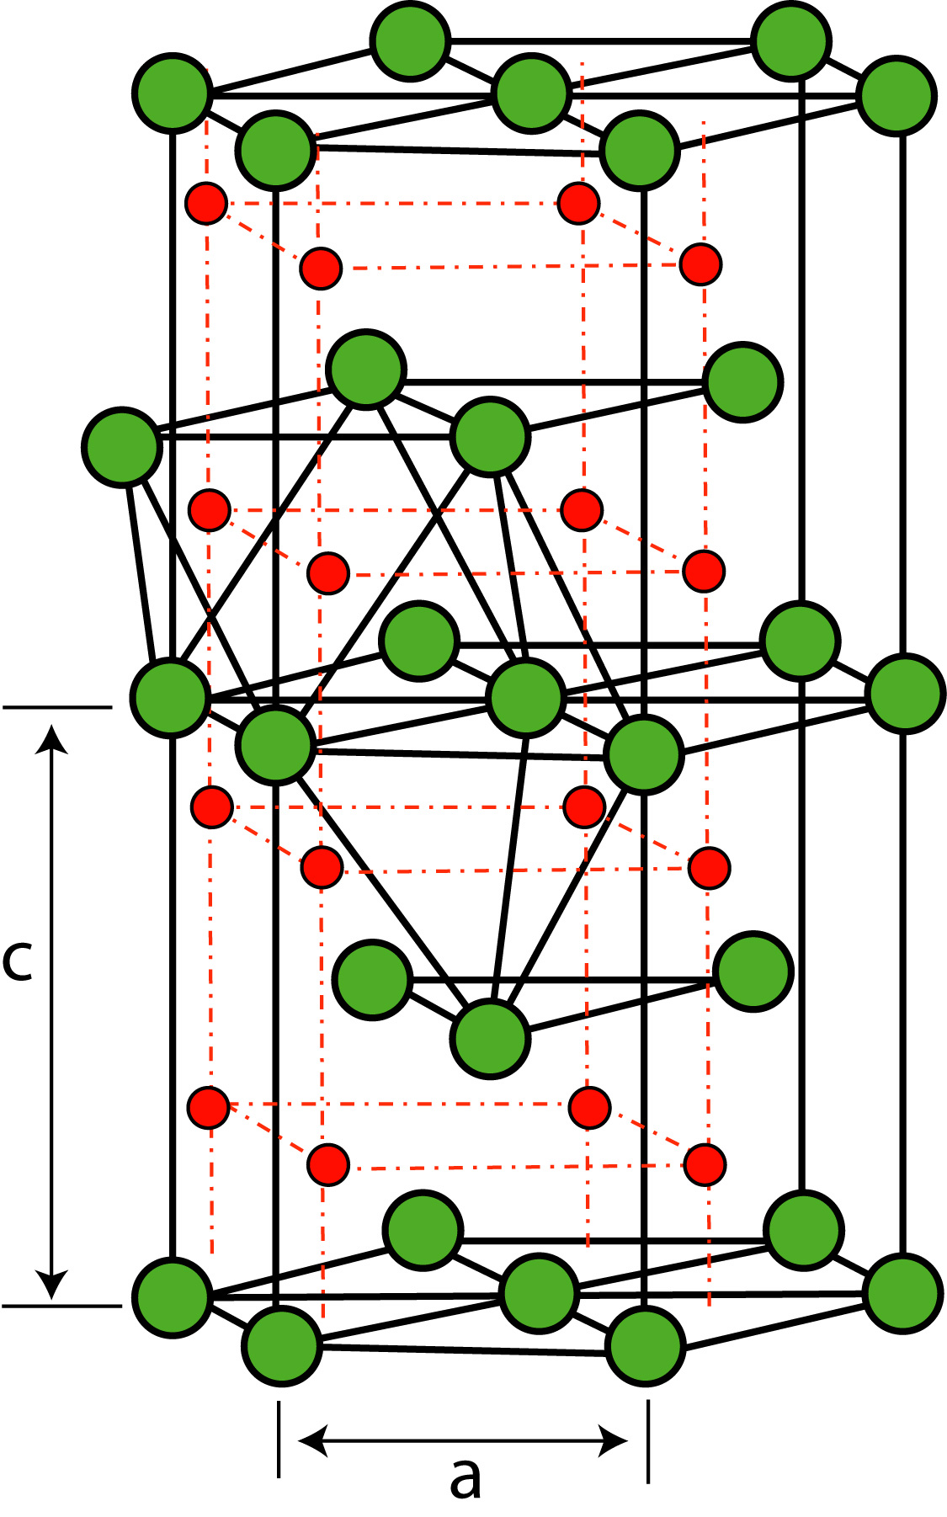
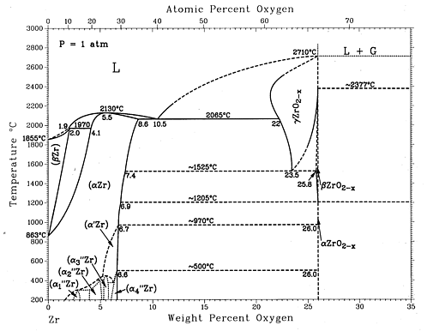
Tutorial Project: Zr-O binary system
Zr:
Very high O solubility
ZrO_{x}
Series of suboxide phases
ZrO_{2-x}
Oxide
J.P. Abriata, J. Garcés, and R. Versaci, Bulletin of Alloy Phase Diagrams Vol. 7 No. 2 1986 .

Slide 8
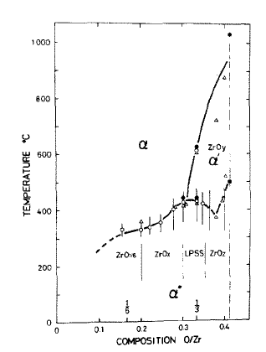
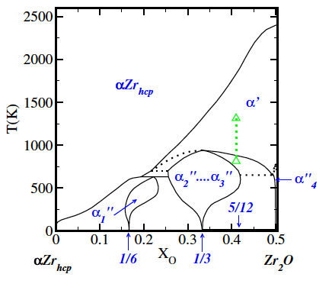
Nature of ZrO_{1/2} disordering transitions?
“the rearrangement of the oxygen atoms from uneven to even distribution on the neighboring interstice planes, and then [to a] random distribution in each plane.” or is low temperature transition first order?
Arai and Hirabayashi, J. Less-Common Metals, 44, 291 (1976).
Burton, Van de Walle, and Stokes, J. Phys. Soc. Japan, 81, 014004 (2012).

Slide 9
Problem Definition

Slide 10
Problem Definition

Slide 11
Problem Definition
b
Lattice Vectors
a
y
x

Slide 12
Problem Definition
b
Lattice Vectors
Basis Atoms
a
y
x

Slide 13
Problem Definition
prim.json:
{
"title" : "ZrO”,
"coordinate_mode" : "Fractional",
"description" : “HCP Zr with oct (O) ",
"lattice_vectors" : [
[ 3.233986860000, 0.000000000000, 0.000000000000 ],
[ -1.616993430000, 2.800714770000, 0.000000000000 ],
[ -0.000000000000, 0.000000000000, 5.168678340000 ]
],
"basis" : [
{
"coordinate" : [ 0.0000000, 0.0000000, 0.000000 ],
"occupant_dof" : [ "Zr" ]
},
{
"coordinate" : [ 0.6666667, 0.3333334, 0.500000 ],
"occupant_dof" : [ "Zr" ]
},
{
"coordinate" : [ 0.3333333, 0.6666667, 0.250000 ],
"occupant_dof" : [ "Va", "O" ]
},
{
"coordinate" : [ 0.3333333, 0.6666667, 0.750000 ],
"occupant_dof" : [ "Va", "O" ]
}
]
}
b
Lattice Vectors
Basis Atoms
a
y
x

Slide 14
Problem Definition
prim.json:
{
"title" : "ZrO”,
"coordinate_mode" : "Fractional",
"description" : “HCP Zr with oct (O) ",
"lattice_vectors" : [
[ 3.233986860000, 0.000000000000, 0.000000000000 ],
[ -1.616993430000, 2.800714770000, 0.000000000000 ],
[ -0.000000000000, 0.000000000000, 5.168678340000 ]
],
"basis" : [
{
"coordinate" : [ 0.0000000, 0.0000000, 0.000000 ],
"occupant_dof" : [ "Zr" ]
},
{
"coordinate" : [ 0.6666667, 0.3333334, 0.500000 ],
"occupant_dof" : [ "Zr" ]
},
{
"coordinate" : [ 0.3333333, 0.6666667, 0.250000 ],
"occupant_dof" : [ "Va", "O" ]
},
{
"coordinate" : [ 0.3333333, 0.6666667, 0.750000 ],
"occupant_dof" : [ "Va", "O" ]
}
]
}
a
b
b
c
x
y
z
Basis Atoms
Lattice Vectors
a
y
x

Slide 15
Problem Definition
prim.json:
{
"title" : "ZrO”,
"coordinate_mode" : "Fractional",
"description" : “HCP Zr with oct (O) ",
"lattice_vectors" : [
[ 3.233986860000, 0.000000000000, 0.000000000000 ],
[ -1.616993430000, 2.800714770000, 0.000000000000 ],
[ -0.000000000000, 0.000000000000, 5.168678340000 ]
],
"basis" : [
{
"coordinate" : [ 0.0000000, 0.0000000, 0.000000 ],
"occupant_dof" : [ "Zr" ]
},
{
"coordinate" : [ 0.6666667, 0.3333334, 0.500000 ],
"occupant_dof" : [ "Zr" ]
},
{
"coordinate" : [ 0.3333333, 0.6666667, 0.250000 ],
"occupant_dof" : [ "Va", "O" ]
},
{
"coordinate" : [ 0.3333333, 0.6666667, 0.750000 ],
"occupant_dof" : [ "Va", "O" ]
}
]
}
a
b
b
c
x
y
z
Basis Atoms
Lattice Vectors
a
y
x

Slide 16
Problem Definition
prim.json:
{
"title" : "ZrO”,
"coordinate_mode" : "Fractional",
"description" : “HCP Zr with oct (O) ",
"lattice_vectors" : [
[ 3.233986860000, 0.000000000000, 0.000000000000 ],
[ -1.616993430000, 2.800714770000, 0.000000000000 ],
[ -0.000000000000, 0.000000000000, 5.168678340000 ]
],
"basis" : [
{
"coordinate" : [ 0.0000000, 0.0000000, 0.000000 ],
"occupant_dof" : [ "Zr" ]
},
{
"coordinate" : [ 0.6666667, 0.3333334, 0.500000 ],
"occupant_dof" : [ "Zr" ]
},
{
"coordinate" : [ 0.3333333, 0.6666667, 0.250000 ],
"occupant_dof" : [ "Va", "O" ]
},
{
"coordinate" : [ 0.3333333, 0.6666667, 0.750000 ],
"occupant_dof" : [ "Va", "O" ]
}
]
}
a
b
b
c
x
y
z
Basis Atoms
Lattice Vectors
a
y
x
JSON: JavaScript Object Notation

Slide 17
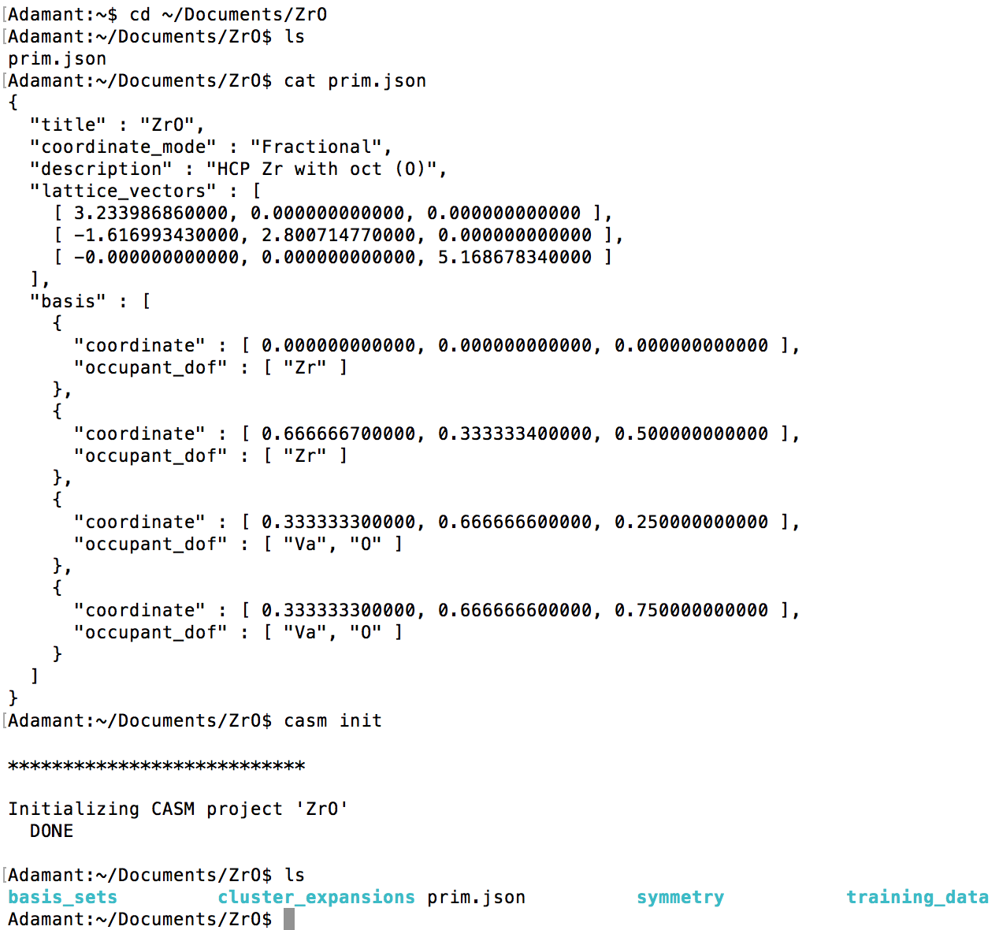
CASM: Getting started
Material
definition
Initialization
Generated
directories

Slide 18
CASM: Getting started
Install 'casm' command line programs
'casm status'
Quick look at your current project
'-n' option: suggestions for next steps
'casm format'
Documentation of project directory and file formats
'casm –h'
Help menus show allowed options

Slide 19
Crystal Symmetry
Apply rotation, reflection, inversion, and/or rotation to the crystal.

Slide 20
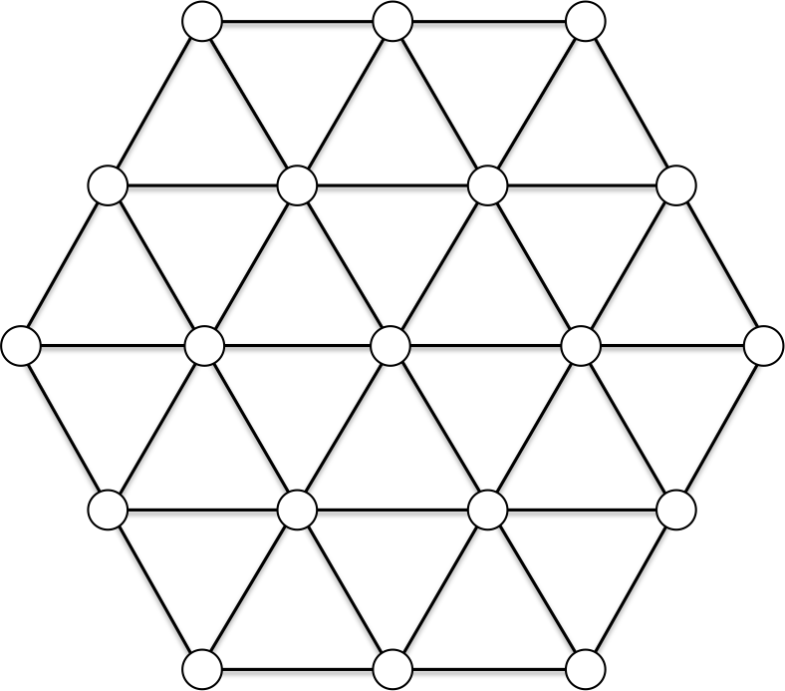
Crystal Symmetry
Apply rotation, reflection, inversion, and/or rotation to the crystal.
60°

Slide 21
Crystal Symmetry
Apply rotation, reflection, inversion, and/or rotation to the crystal.
If the result is indistinguishable from the initial state, then that operation is in the crystal’s space group.
60°

Slide 22
Crystal Symmetry
Common notation: {R_{α}|τ}
R_{α}: point group operations such as rotations, reflections, improper rotations, inversions
τ: translation vector
α: 3x3 transformation matrix
M.S. Dresselhaus, G. Dresselhaus, and A. Jorio.
Group Theory: Application to the Physics of Condensed Matter.

Slide 23
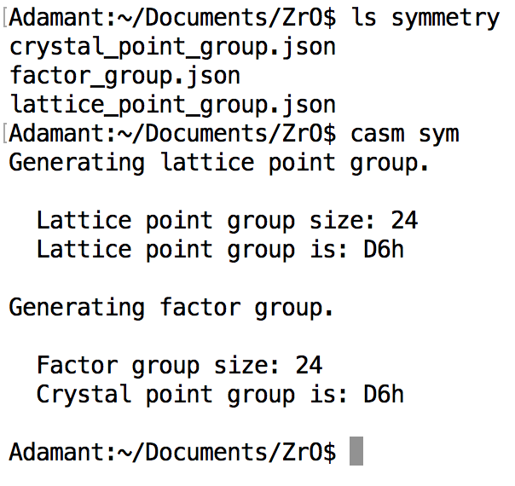
Symmetry
Lattice point group:
Symmetry operations that map lattice onto itself, leaving origin invariant (rotation, mirror, inversion, rotoinversion)
Crystal factor group:
Symmetry operations that map lattice and identical basis sites onto themselves (translations may result in screw axes or glide planes)
Crystal point group:
Crystal factor group operations, with translations removed

Slide 24
Crystal Configurations

Slide 25
Crystal Configurations

Slide 26
Crystal Configurations
Vol 2 Supercell
Vol 4 Supercell

Slide 27
Crystal Configurations

Slide 28
Crystal Configurations
Equivalent!!
60°

Slide 29
Supercell Enumeration
S₁=P₁ S₂=2P₂
Represent lattice using column vector matrices:
P: primitive lattice
S: supercell lattice
T: integer supercell transformation matrix
S₂
S₁
P₂
S₂
S₁
S₁=P₁+P₂ S₂=-P₁+P₂
P₁

Slide 30
Supercell Enumeration
Equivalent supercells:
Linear combination of supercell lattice vectors
S
S'

Slide 31
Supercell Enumeration
Equivalent supercells:
Linear combination of symmetrically equivalent supercell lattice vectors
For a crystal, allowed symmetry operations depends on crystal basis
S
S'

Slide 32
Supercell enumeration
If unit cell lattice, P, is represented as column vector matrix, then supercell lattices, S, are:
T is an integer supercell transformation matrix, and S has integer volume det(T), relative to the primitive cell.
Supercells are equivalent if for some T:
At a given volume (det(T)), loop over possible T matrices and use crystal point group operations to check if we've found a new symmetrically distinct supercell

Slide 33
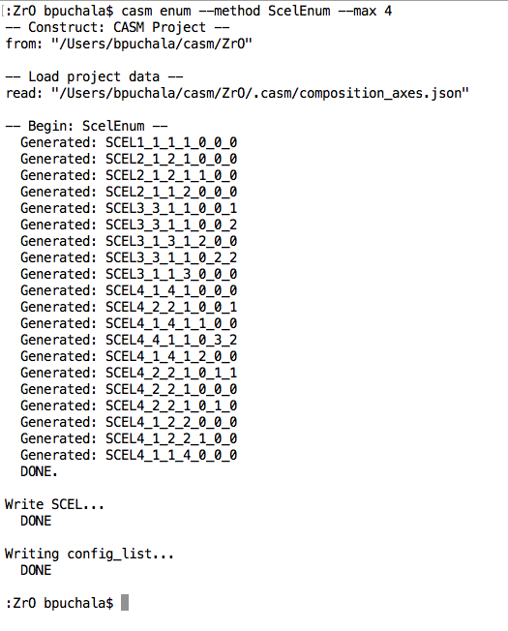
Supercell enumeration
Max an min supercell volume can be specified for enumeration
SCEL4_1_4_1_0_0_0
Supercell enumeration can be restricted to 1D and 2D. See casm enum --help
for details.
Volume
Shape Factors

Slide 34
Configuration enumeration
A:
Equivalent configurations:
Supercells of the volume 1 configuration
B:

Slide 35
Configuration enumeration
A:
Equivalent configurations:
Translation maps one configuration onto the other
B:

Slide 36
Configuration enumeration
A:
Equivalent configurations:
Rotation or translation maps occupants
B:

Slide 37
Configuration enumeration
Enumerate symmetrically unique configurations by:
Loop over possible occupations
Check all factor group operations that keep the supercell lattice vectors unchanged, in combination with all primitive cell translations within the supercell
If translation within the supercell alone maps all occupants, then it is a supercell of a smaller primitive configuration

Slide 38
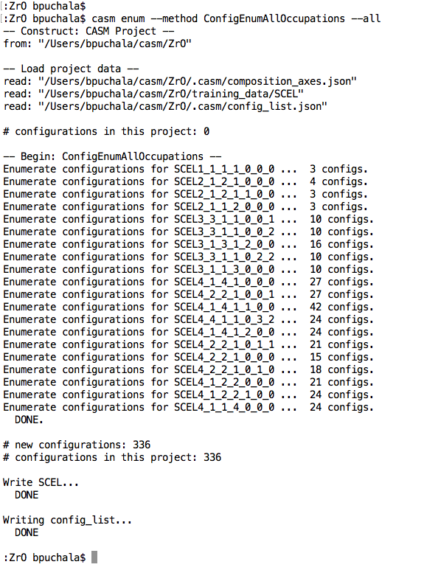
Configuration enumeration
Configurations are enumerated ONLY in supercells that have been enumerated.
You can specify the min and max supercell volumes, or specify a supercell explicitly.
CAUTION: The number of unique configurations that fit in a supercell grows exponentially with supercell volume.

Slide 39
Configuration visualization
Set up environment:
casm settings --set-view-command 'casm.view VESTA’
Try with one or more configuration names:
casm view SCEL4_2_2_1_0_0_1/25

Slide 40
CASM Composition metrics
Each configuration has a composition, and there are various ways to measure it:
atom_frac: atom_frac(Au), atom_frac(Cu), etc.
Number of Au, Cu, etc., divided by total number of atoms. Vacancies are ignored.
comp_n: comp_n(Au), comp_n(Cu), etc.
Number of Au, Cu, etc., divided by number of primitive cells (volume). Accounts for vacancies.
comp: comp(a), comp(b), etc.
Primitive-cell-based formula parameters (e.g., Au_{a}Cu_{b}Pt_{(1-a-b)}), determined by user-specified composition axes. Accounts for vacancies.
When vacancies are present, ‘atom_frac’ is qualitatively different from ‘comp_n’ and ‘comp’

Slide 41
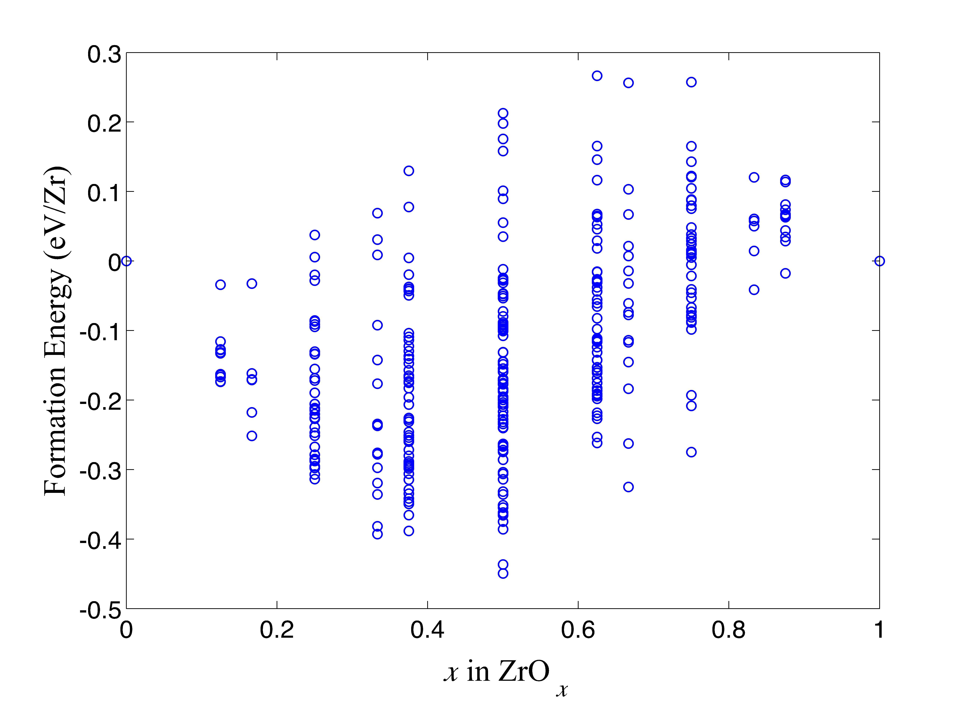
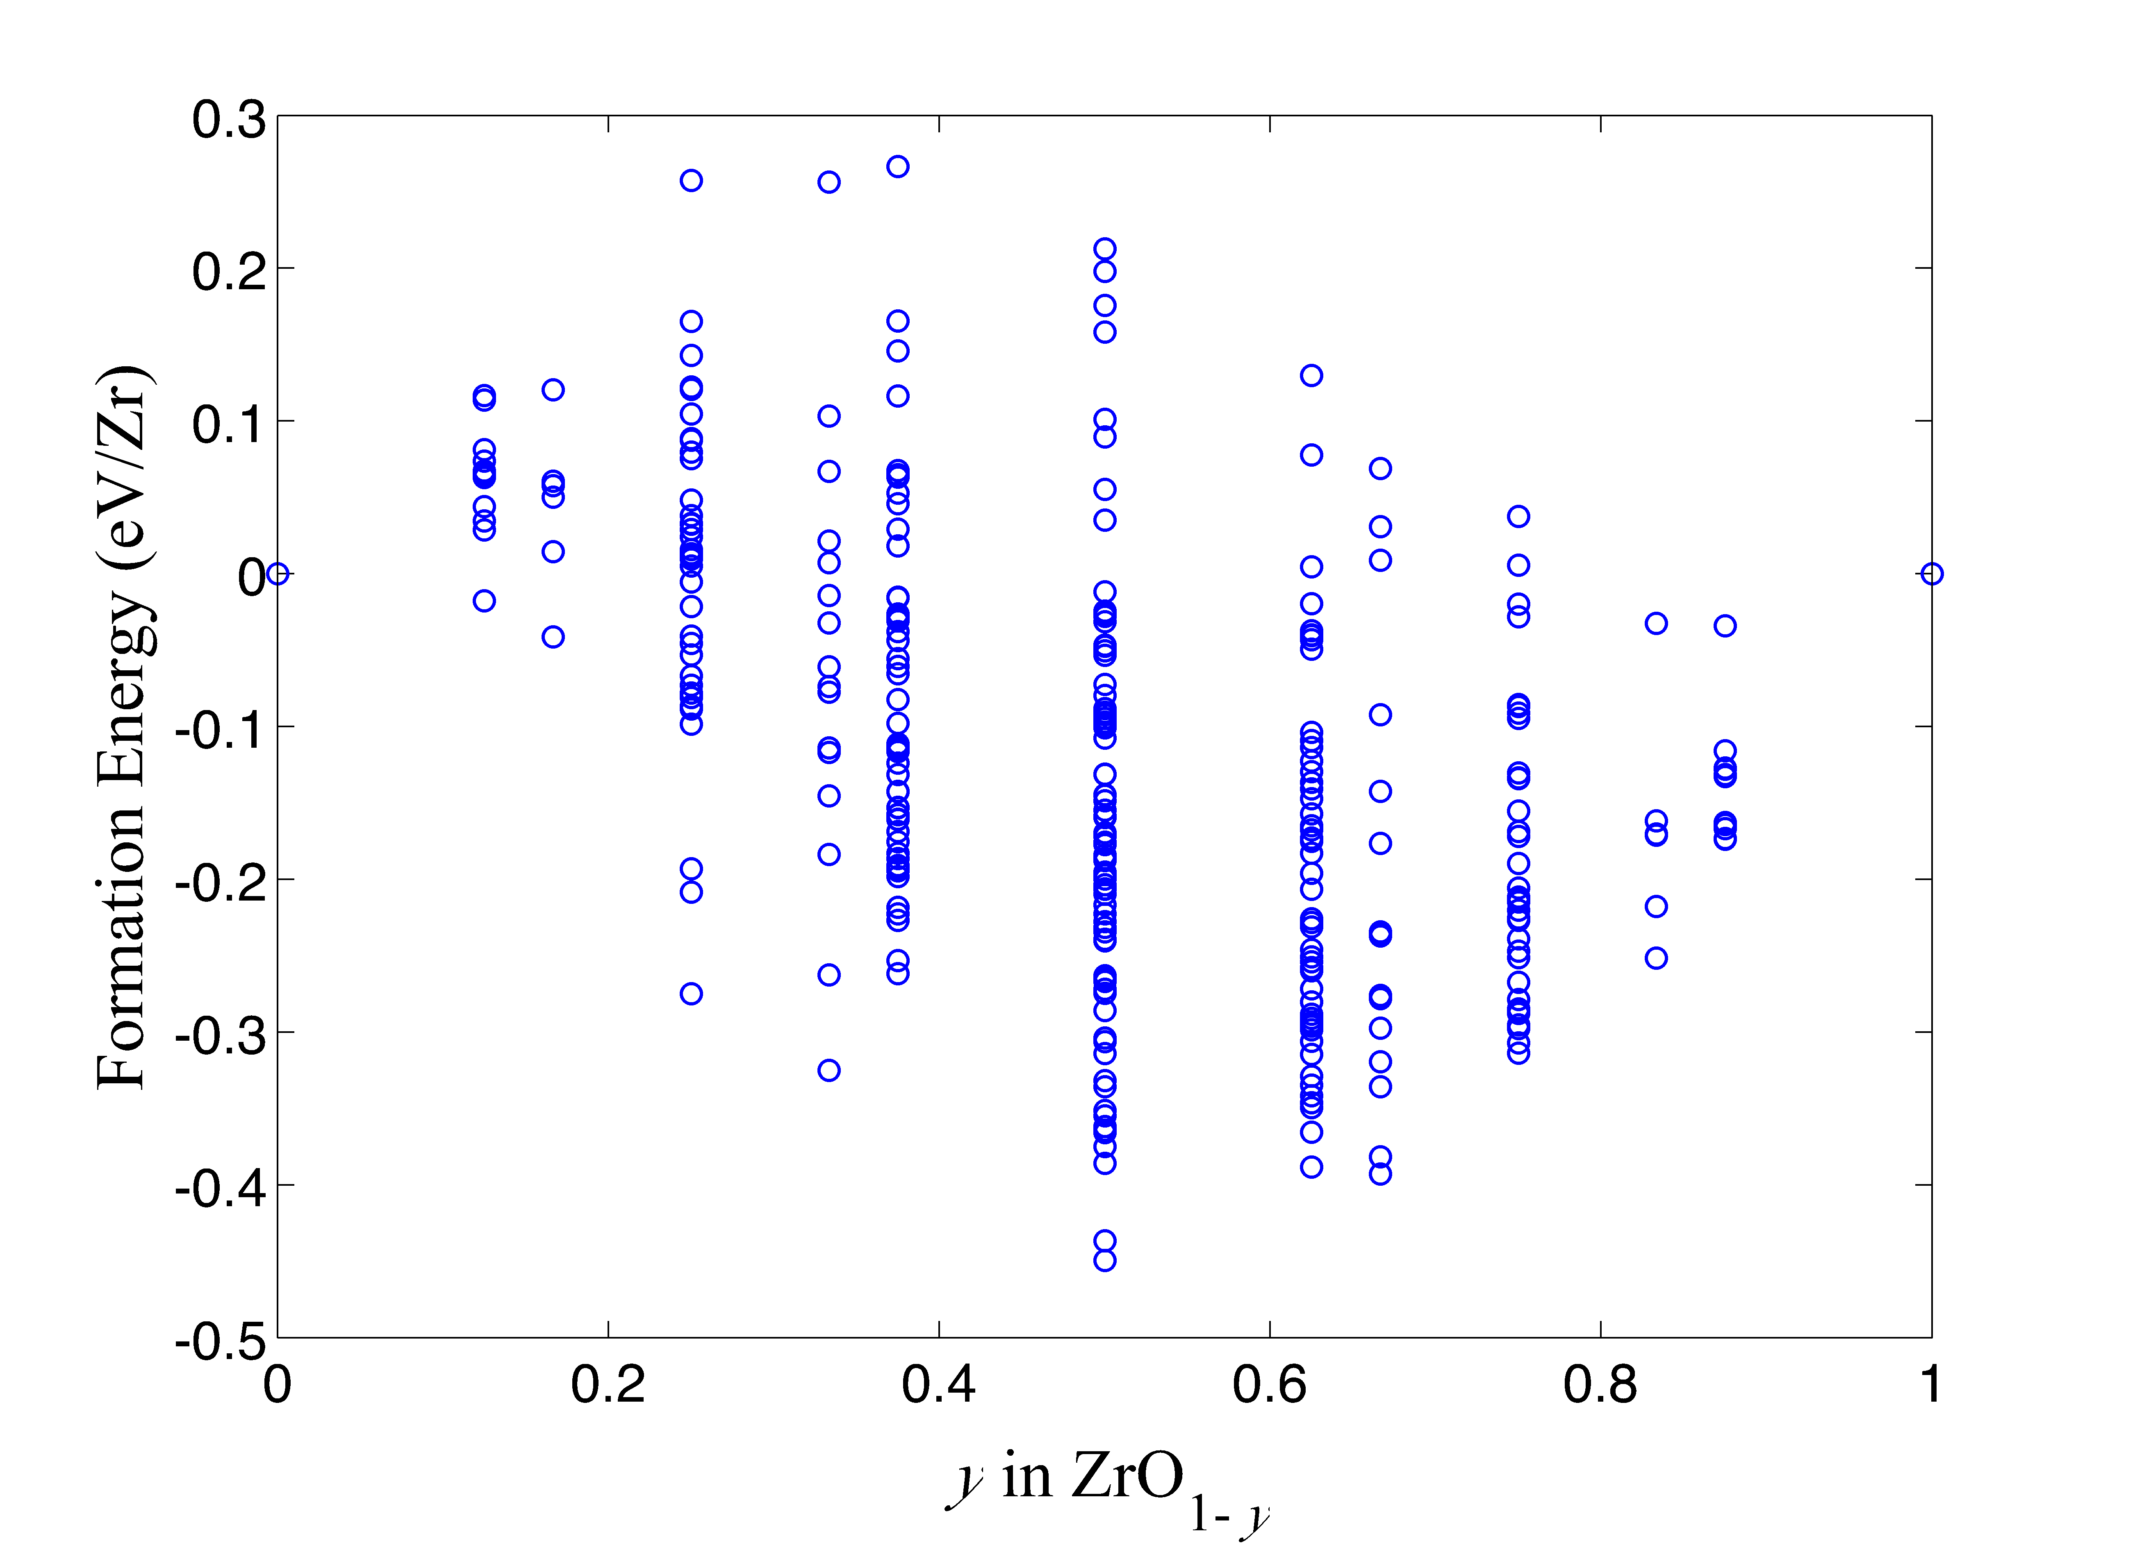
Specifying composition axes
Binary Compound:

Slide 42
Specifying composition axes
Binary Compound:
Ternary Compound:
Au
b
a
Cu_{1-a-b}Au_{b}Pt_{a}
Cu_{b}Au_{a}Pt_{1-a-b}
Cu
a
b
Pt

Slide 43
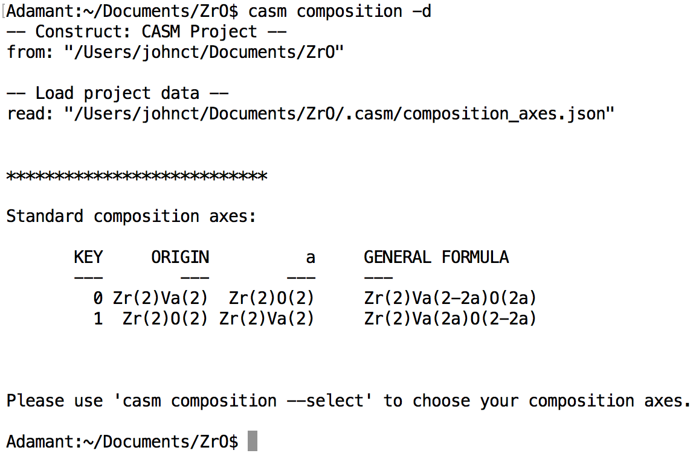
Specifying composition axes
Zr₂O_{2a}[Va]_{2(1-a)}
Zr₂O_{2(1-a)}[Va]_{2a}
NOTE: prim.json determines formula unit (2 Zr)

Slide 44
Data Management
Project data is managed according to the parameters, settings, and timeline that it depends on:
‘calctype’ DFT parameters and setting (XC functional, pseudopotential, convergence parameters, etc.)
‘property’ The particular quantity being measured (formation_energy, volume_relaxation, etc.)
‘ref’ Baseline reference used for measuring quantity (zero-point of energy, reference volume, etc.)
‘bset’ Basis functions used to “fingerprint” configurations and in terms of which the property model is expressed .
‘eci’ The model parameters (effective cluster interactions) used to predict a particular property in terms of a particular basis set.
Manage and create settings profiles from the ‘casm settings’ command. A ‘default’ profile is created during project initialized.
Ex:
DFT-calculated properties: Depend on ‘calctype’, ‘property’, and sometimes ‘ref’
Cluster expansion/physics model: Depends on ‘calctype’, ‘property’, ‘ref’, ‘bset’
Predicted properties and Monte Carlo Data: Depend on ‘calctype’, ‘property’, ‘ref’, ‘bset’, and ‘eci’

Slide 45
Data Management Workflow
Configuration Database
Records configurations that have been enumerated or imported to a project and their associated data
Configuration Selection
Configuration Selection
References to subset of the configuration database.
CASM
Job Dispatch
Info/Analysis

Slide 46
Working with selections
CASM query syntax provides simple interface to explore, screen, and select configurations.
Example:
casm select --set "eq(scel_size, 4)"
will select all configurations the belong to supercells of volume 4 (relative to primitive cell)
Many configuration properties are supported
‘scel_size’ Integer volume of supercell that contains the configuration
‘comp(a)’, ‘comp(b)’, etc. The chemical composition, in terms of composition axes
‘atom_frac(Au)’, etc. The atomic fraction of a particular specie
‘is_calculated’ True if DFT data exists for the configuration
‘formation_energy’ DFT formation energy (if calculated)
‘volume relaxation Change in volume due to relaxation (expressed as V/V₀)
… and many others (for full listing see casm select --help properties)
Properties can be related and compared via operators
arithmetic add, subtract, multiply, divide, sqrt, exp
comparison equality, less-than, greater-than, etc.
logical AND, OR, NOT, etc.
ranges min, max, and others
text search and match with regular expressions
for documentation see casm select --help operators

Slide 47
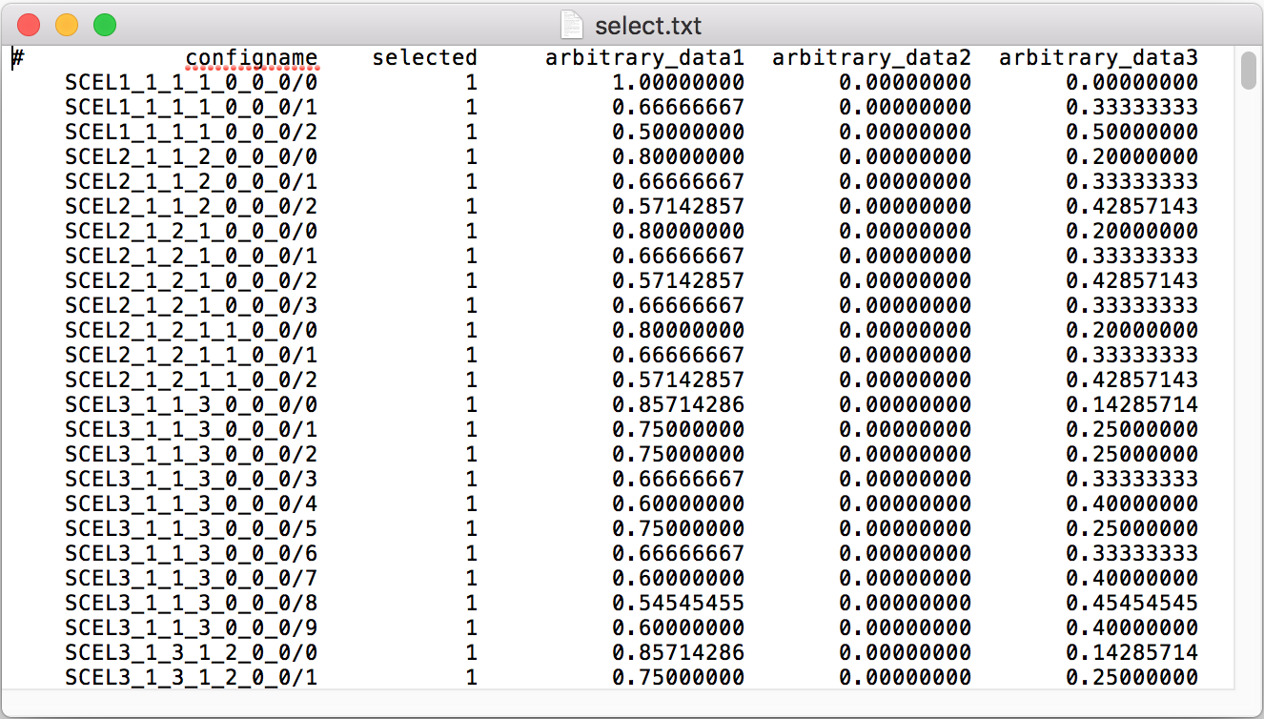
Working with selections
Selections can be edited and combined using ‘casm select’
The ‘MASTER’ selection is stored in the configuration database and is the default selection for most operations. A selection can be redirected to a file using --output <filename>
Selection(s) to be operated can be read from a file using --configs <filename>
Edit selections using CASM query syntax
casm select --set <query> Create a selection from scratch
casm select --set-on <query> Set ‘selected’ from false to true if <query> is true
casm select --set-off <query> Set ‘selected’ from true to false if <query> is true
Combine selections using logical operators (AND, OR, NOT, XOR)

Slide 48
Working with selections
Selections can be edited and combined using ‘casm select’
The ‘MASTER’ selection is stored in the configuration database and is the default selection for most operations. A selection can be redirected to a file using --output <filename>
Selection(s) to be operated can be read from a file using --configs <filename>
Edit selections using CASM query syntax
casm select --set <query> Create a selection from scratch
casm select --set-on <query> Set ‘selected’ from false to true if <query> is true
casm select --set-off <query> Set ‘selected’ from true to false if <query> is true
Combine selections using logical operators (AND, OR, NOT, XOR)
Predefined selections:
‘ALL’: specifies the total configuration database.
‘CALCULATED’: specifies all configurations for which DFT data exist.
‘NONE’: equivalent to ‘ALL’ but with all ‘selected’ bits set to 0

Slide 49
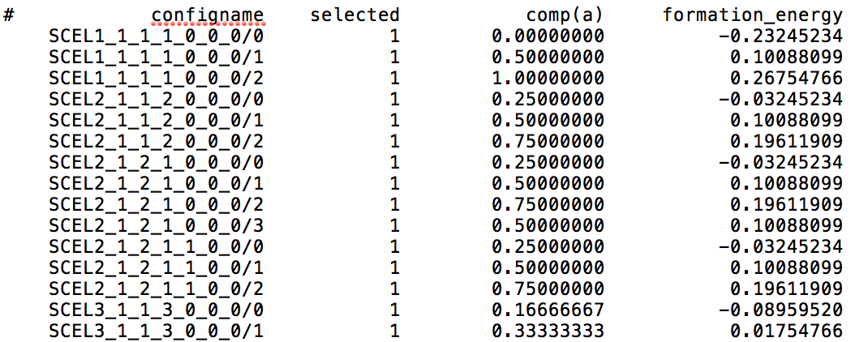
CASM Query Syntax, Part II
CASM query syntax provides simple interface to explore, screen, and select configurations.
Use ‘casm query’ to print properties of selected configurations (supports JSON and CSV)
Example:
casm query --columns "comp(a)" "formation_energy" --configs select.csv
will print ‘casm select’-style CSV output to the screen:
output can be redirected to a file with --output <filename>
Query syntax can also be used to screen configurations at the enumeration stage, so they don’t pollute the configuration database.
Example:
casm enum --configurations --all --filter "lt(atom_frac(O),0.25)"
will only enumerate configurations that are dilute in oxygen (having O atomic fraction less than 0.25)

Slide 50
DFT calculations
Provide DFT code input files and parameters
Pseudopotentials, k-point density, energy cut-off, and settings files
Use ‘casm select’ to identify a selection of configurations to calculate
casm-calc --submit --configs my_selection.csv
vasp.relax is python script that automates job submission for each configuration. It submits the DFT calculation, handles common errors, ensures that results are converged and relaxed, and writes results to a format CASM understands (properties.calc.json).
Uses ‘pbs’ python module to automate job submission (https://github.com/prisms-center/pbs)
Current support for VASP and SeqQeust; QuantumEspresso partially completed, and support for other codes is planned. Contributions from the user community are encouraged!

Slide 51
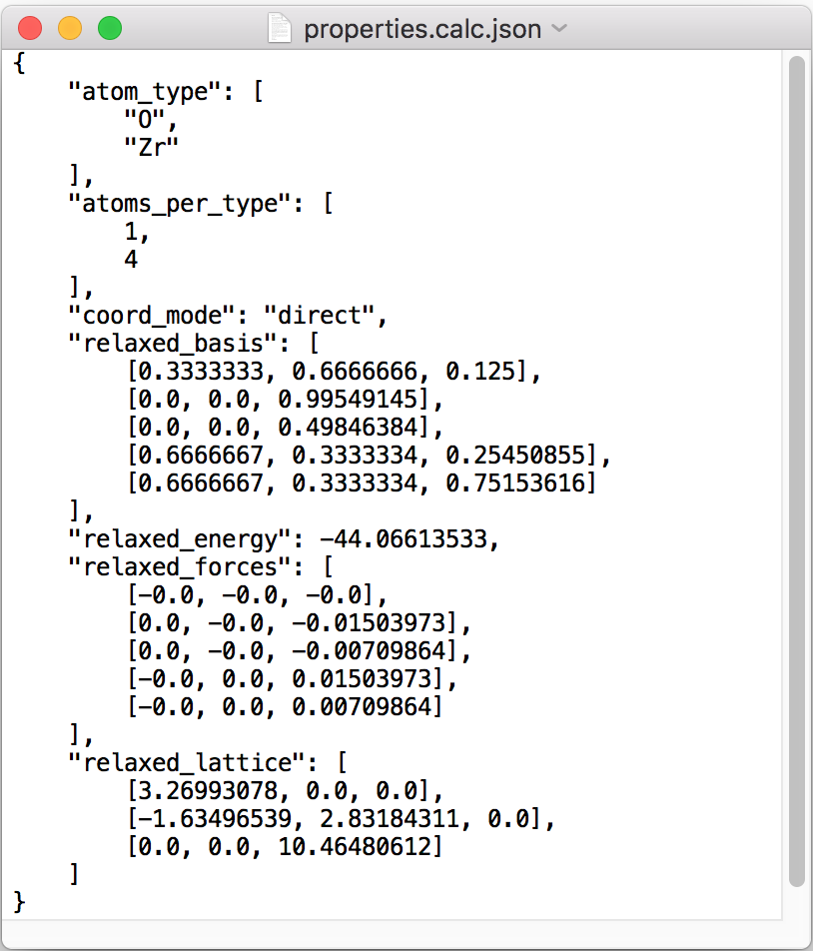
properties.calc.json files
$ROOT/training_data/$SCEL/$CONFIGID/calctype.$CALCTYPE/
CASM interprets calculation data from properties.calc.json file
Generated by ‘vasp.relax’ or manually using ‘vasp.relax.report’

Slide 52

Relaxations and Mapping/Import
casm update:
Read all new property files, and check relaxation
lattice_deformation (LD):
Degree of homogeneous strain (per atom)
basis_deformation (BD):
Mean square displacement
total deformation cost:
w*LD+(1-w)*BD , 0<w<1
casm import:
Use same algorithms as casm update to add ideal or relaxed configurations to project (even if not enumerated)
Very large relaxations may change the configuration. Conflicts can be resolved using either min-energy or min-deformation rule

Slide 53
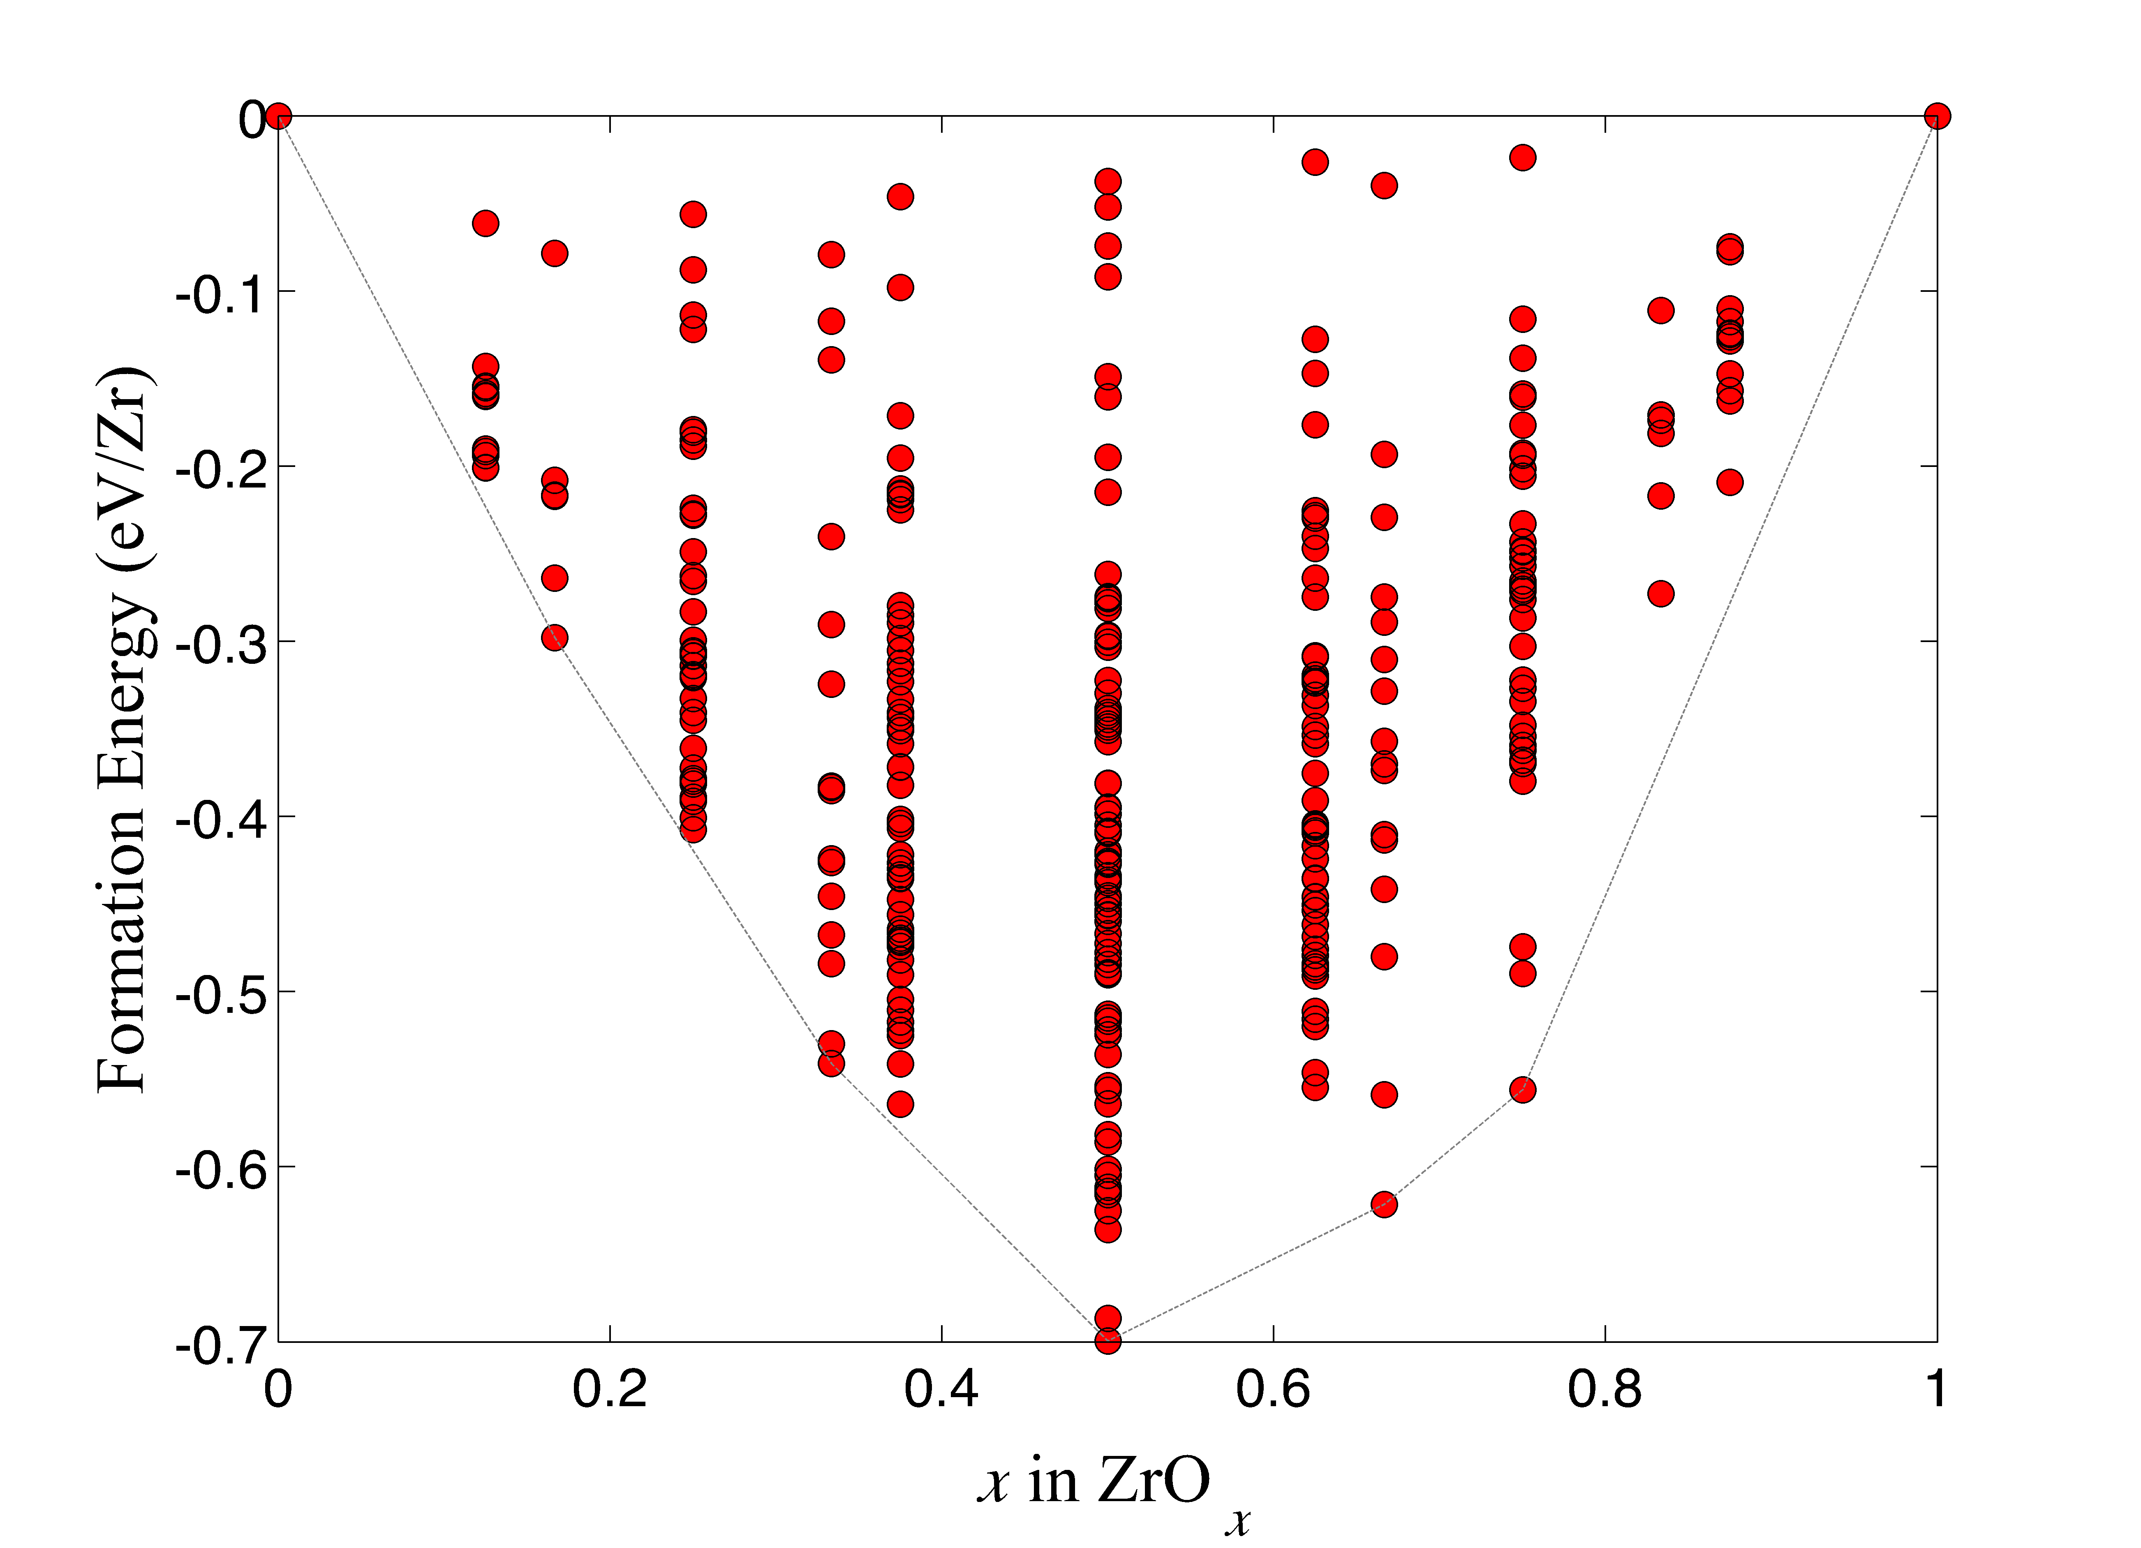
Setting energy reference
Chemical energy can only be measured relative to reference compounds

Slide 54
Setting energy reference
Chemical energy can only be measured relative to reference compounds

Slide 55
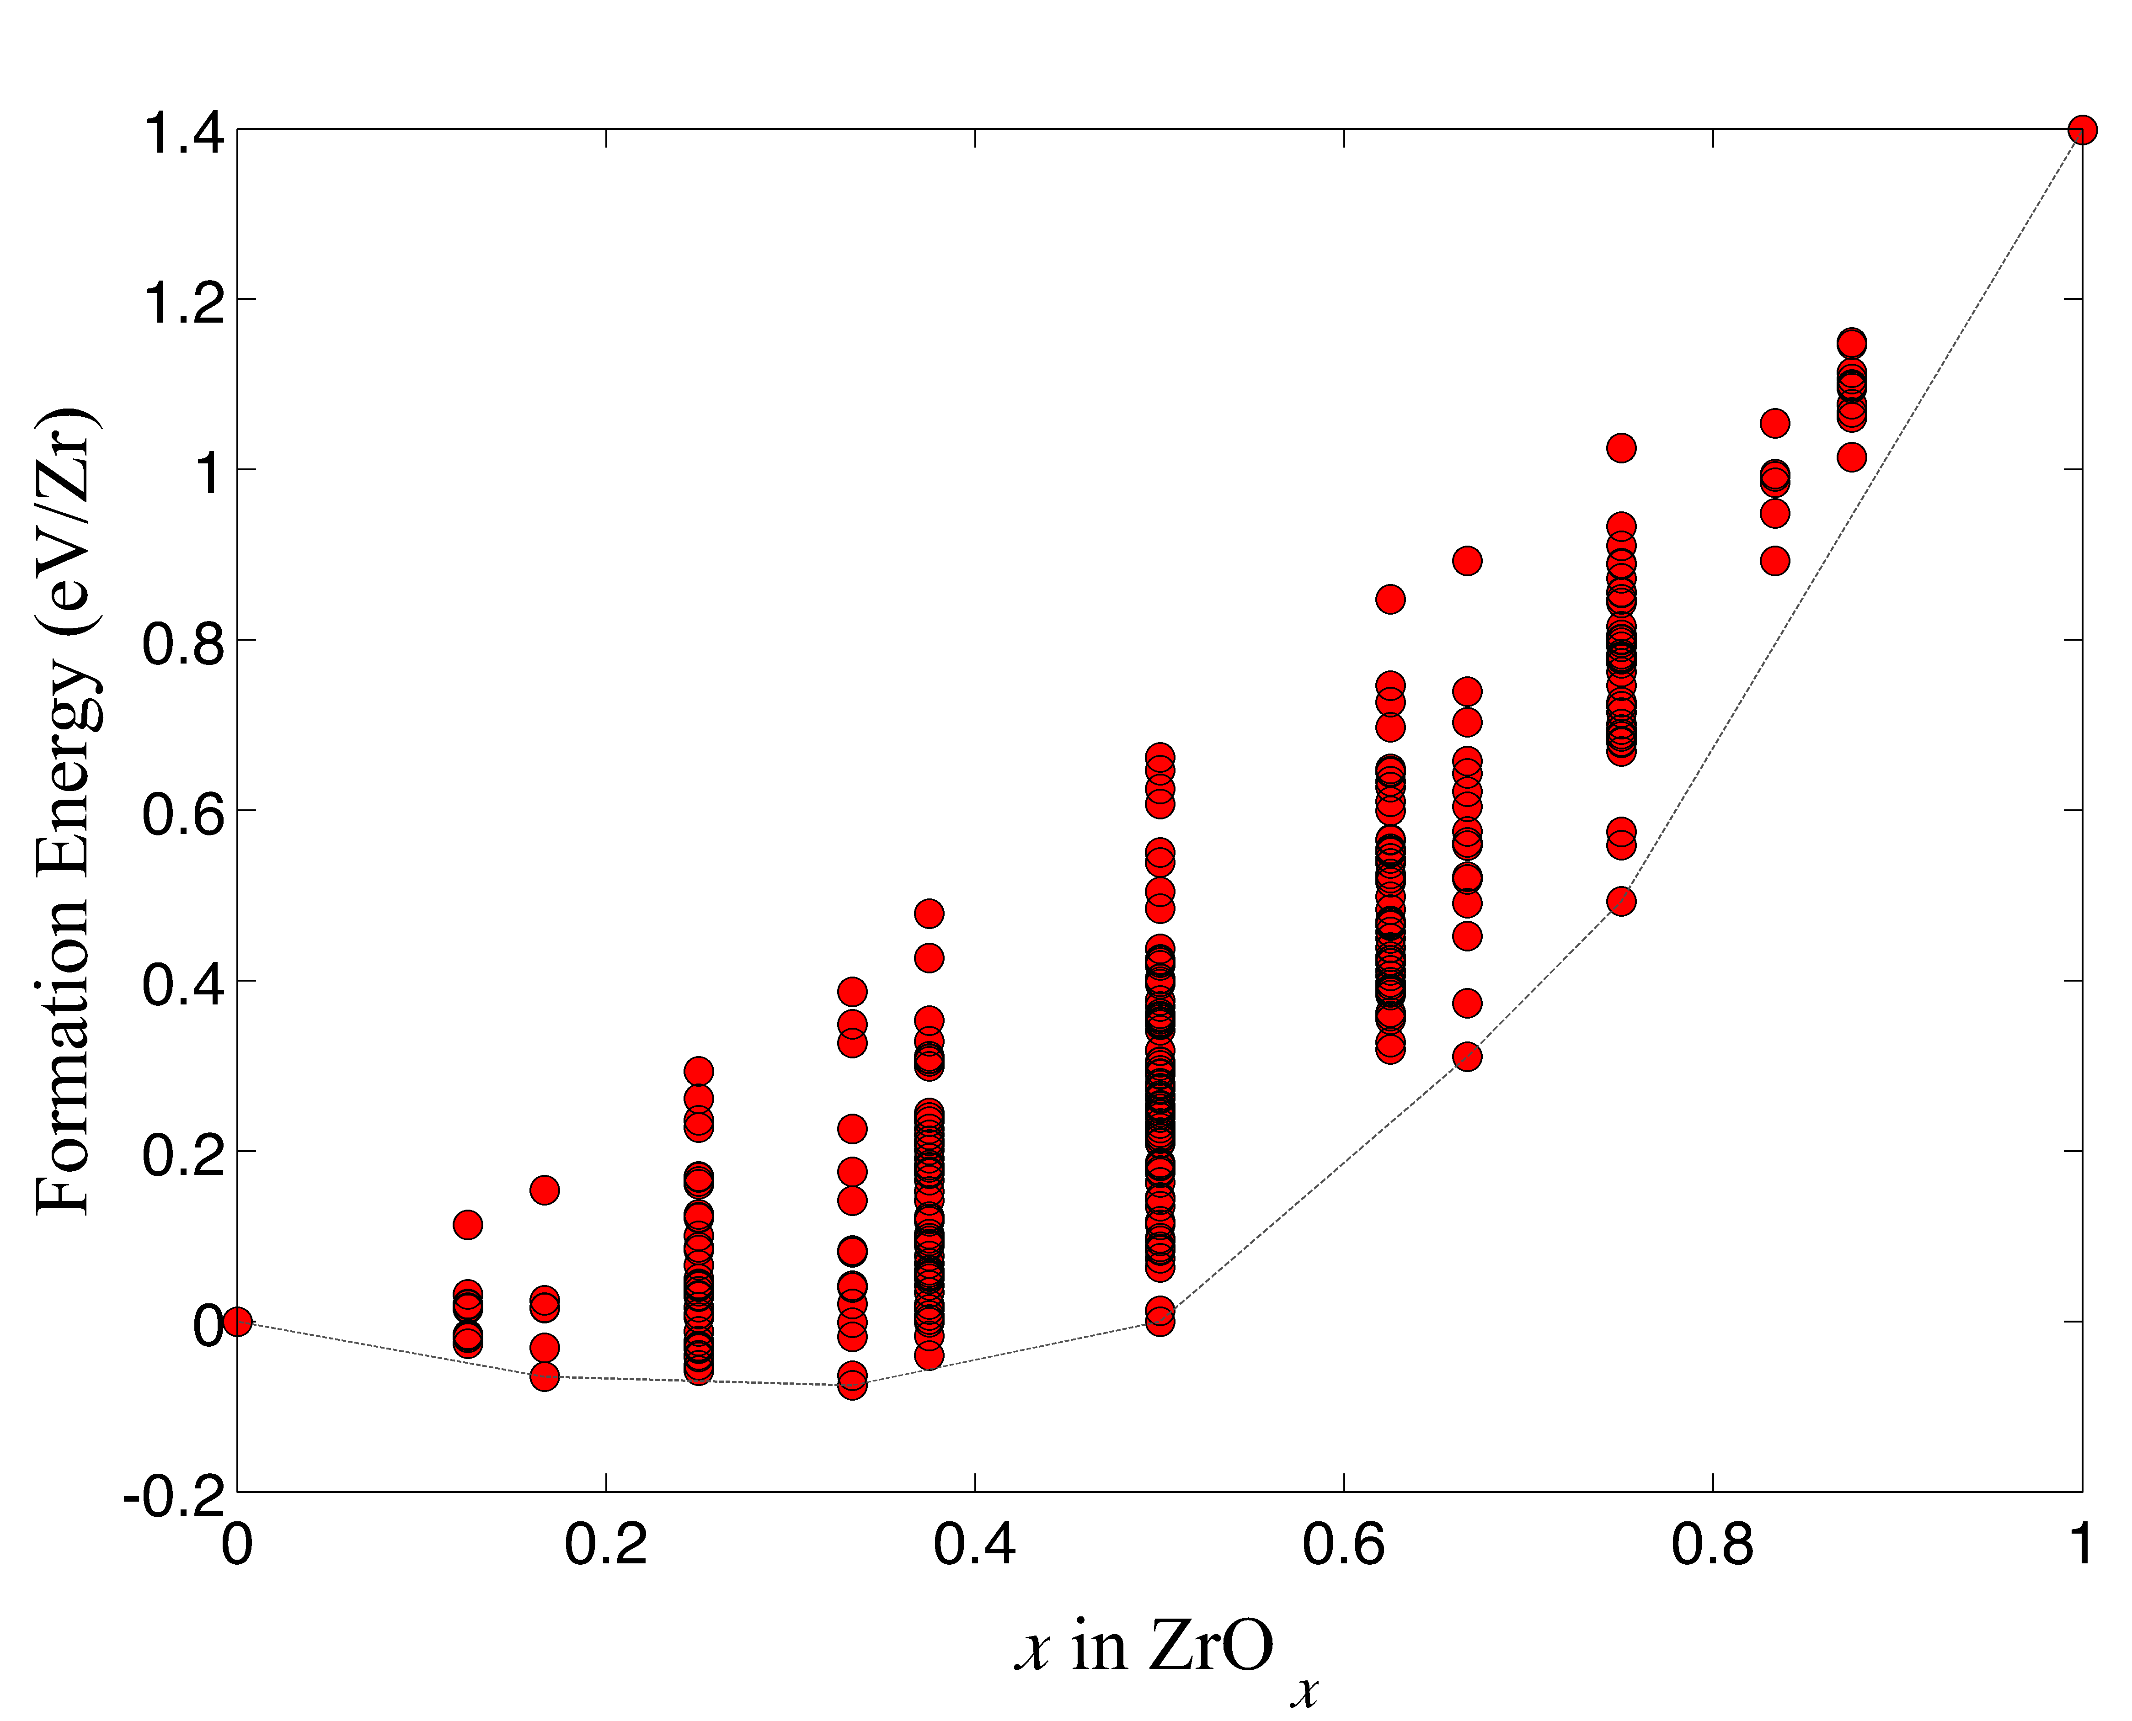
Setting energy reference
Chemical energy can only be measured relative to reference compounds
casm ref --set-auto will attempt to set energy references as near to extreme stoichiometries as possible (left case)

Slide 56
CASM: Clusters Approach to Statistical Mechanics
First-principles energies of a “few” excitations
Extrapolate to
all other excitations
Lattice Model Hamiltonian
Monte Carlo
Thermodynamics

Slide 57
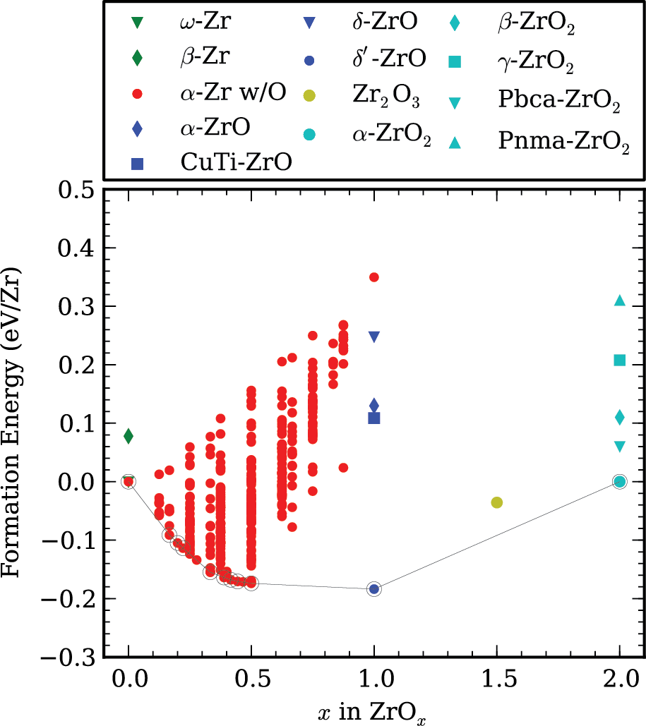
Zr-O system
Each red circle specifies belongs to a specific configuration of HCP-based ZrO_{x}
Puchala and Van der Ven, Phys. Rev. B 88 094108 (2013).

Slide 58
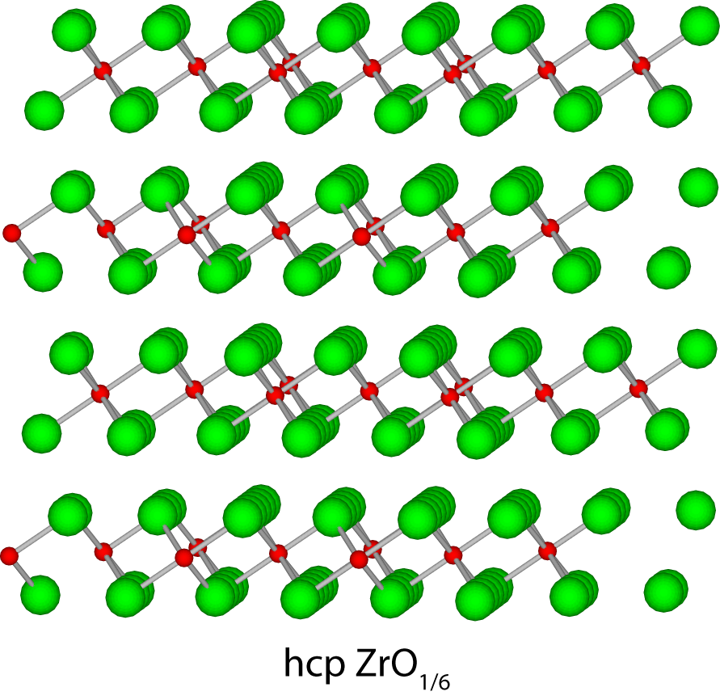
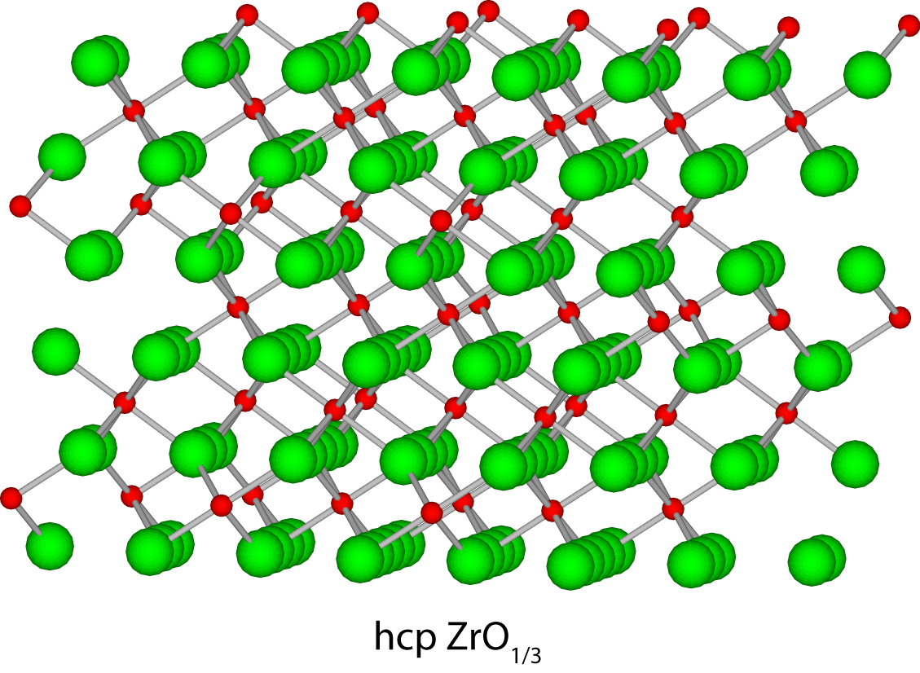
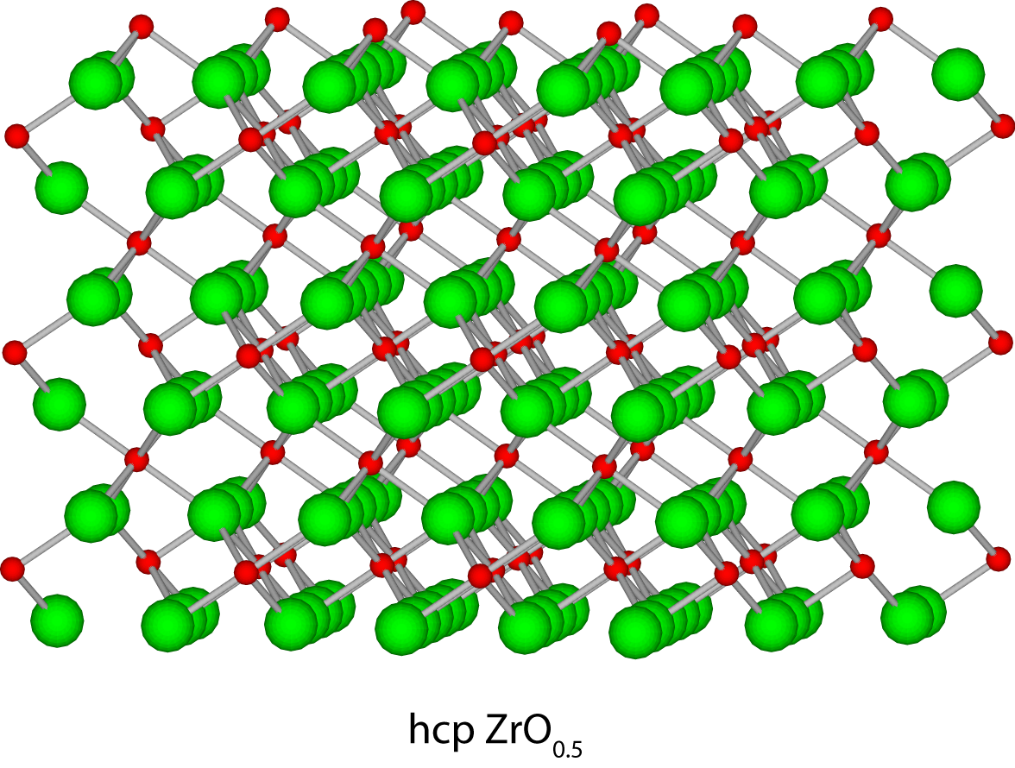
Zr-O system
A
A
A
-
B
BC
B
C
A
-
A
BC
C
-
B
A
A
C
BC
ZrO_{1/6}
ZrO_{1/3}
ZrO_{1/2}
Puchala and Van der Ven, Phys. Rev. B 88 094108 (2013).

Slide 59
Zr-O system
ZrO_{1/6} if X = 0
ZrO_{1/2} if X = 2/3
ZrO_{1/6}-ZrO_{1/3}
ZrO_{1/3}-ZrO_{1/2}
O stacking sequences
Puchala and Van der Ven, Phys. Rev. B 88 094108 (2013).
de Fontaine, Nature 343, 544 (1990).

Slide 60
CASM: Clusters Approach to Statistical Mechanics
First-principles energies of a “few” excitations
Extrapolate to
all other excitations
Lattice Model Hamiltonian
Monte Carlo
Thermodynamics

Slide 61
The Clusters Approach to Statistical Mechanics
Is there a compact way to approximate the energy of any configuration?
y
x

Slide 62
The Clusters Approach to Statistical Mechanics
Is there a compact way to approximate the energy of any configuration?
y
x
Species A
Species B

Slide 63
The Clusters Approach to Statistical Mechanics
Is there a compact way to approximate the energy of any configuration?
y
x
Species A
Species B

Slide 64
The Clusters Approach to Statistical Mechanics
Is there a compact way to approximate the energy of any configuration?
y
x
Species A
Species B

Slide 65
The Clusters Approach to Statistical Mechanics
Is there a compact way to approximate the energy of any configuration?
y
x
Species A
Species B

Slide 66
The Clusters Approach to Statistical Mechanics
Is there a compact way to approximate the energy of any configuration?
y
x
Species A
Species B

Slide 67
The Clusters Approach to Statistical Mechanics
Is there a compact way to approximate the energy of any configuration?
y
x
Species A
Species B

Slide 68
The Clusters Approach to Statistical Mechanics
The orbit of the the NN pair
Is there a compact way to approximate the energy of any configuration?
Symmetric averages of measurements of cluster occupation states.
y
x
Species A
Species B

Slide 69
The Clusters Approach to Statistical Mechanics
Is there a compact way to approximate the energy of any configuration?
Symmetric averages of measurements of cluster occupation states.
y
x
Species A
Species B

Slide 70
The Clusters Approach to Statistical Mechanics
Is there a compact way to approximate the energy of any configuration?
Symmetric averages of measurements of cluster occupation states.
y
x
Species A
Species B

Slide 71
The Cluster Expansion
y
x
Species A
Species B

Slide 72
The Cluster Expansion
σ₁₅
σ₁₆
σ₁₇
The occupant of lattice site i is described by the variable σ_{i} :
σ_{i} = +1 if species A
σ_{i} = -1 if species B
σ₁₄
σ₅
σ₆
σ₁₈
σ₁₃
σ₄
σ₁
σ₇
σ₁₉
σ₁₂
σ₃
σ₂
σ₈
σ₁₁
σ₁₀
σ₉
Species A
Species B

Slide 73
The Cluster Expansion
σ₁₅
σ₁₆
σ₁₇
Interactions between sites are described by products of σ_{i} .
Fit interaction parameters to a database of DFT energies.
σ₁₄
σ₅
σ₆
σ₁₈
σ₁₃
σ₄
σ₁
σ₇
σ₁₉
σ₁₂
σ₃
σ₂
σ₈
σ₁₁
σ₁₀
σ₉
E = J₁σ₁ + J_{1,7}σ₁σ₇ + J_{1,18}σ₁σ₁₈ + J_{1,17}σ₁σ₁₇ + J_{1,4,5}σ₁σ₄σ₅ + . . .
Then use symmetry to average over the entire crystal

Slide 74
Cluster Expansion Example
σ₁₅
σ₁₆
σ₁₇
σ₁₄
σ₅
σ₆
σ₁₈
σ₁₃
σ₄
σ₁
σ₇
σ₁₉
σ₁₂
σ₃
σ₂
σ₈
σ₁₁
σ₁₀
σ₉

Slide 75
Cluster Expansion Example
σ₁₅
σ₁₆
σ₁₇
σ₁₄
σ₅
σ₆
σ₁₈
σ₁₃
σ₄
σ₁
σ₇
σ₁₉
Average site occupation is Γ₁=(σ₁ + σ₆)/2=0
σ₁₂
σ₃
σ₂
σ₈
σ₁₁
σ₁₀
σ₉

Slide 76
Cluster Expansion Example
σ₁₅
σ₁₆
σ₁₇
σ₁₄
σ₅
σ₆
σ₁₈
σ₁₃
σ₄
σ₁
σ₇
σ₁₉
Average site occupation is Γ₁=(σ₁ + σ₆)/2=0
σ₁₂
σ₃
σ₂
σ₈
σ₁₁
σ₁₀
σ₉

Slide 77
Cluster Expansion Example
σ₁₅
σ₁₆
σ₁₇
σ₁₄
σ₅
σ₆
σ₁₈
σ₁₃
σ₄
σ₁
σ₇
σ₁₉
Average site occupation is Γ₁=(σ₁ + σ₆)/2=0
Average NN pair occupation is Γ₂=(σ₁σ₇ + σ₁σ₆ + σ₁σ₅ + σ₆σ₁₈ + σ₆σ₁₇ + σ₆σ₁₆)/6 = 1/3
σ₁₂
σ₃
σ₂
σ₈
σ₁₁
σ₁₀
σ₉

Slide 78
Cluster Expansion Example
σ₁₅
σ₁₆
σ₁₇
σ₁₄
σ₅
σ₆
σ₁₈
σ₁₅
σ₁₆
σ₁₇
σ₁₃
σ₄
σ₁
σ₇
σ₁₉
σ₁₄
σ₅
σ₆
σ₁₈
σ₃
σ₂
σ₈
σ₁₂
σ₁₃
σ₄
σ₁
σ₇
σ₁₉
σ₁₁
σ₁₀
σ₉
σ₁₂
σ₃
σ₂
σ₈
Correlations are identical for symmetrically equivalent configurations
σ₁₁
σ₁₀
σ₉

Slide 79
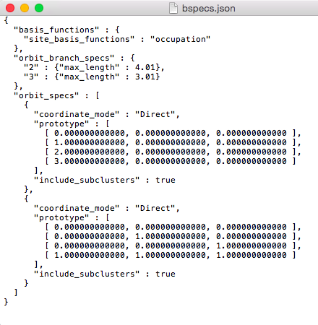
The bspecs.json file
Specifications for generating clusters and the cluster expansion basis functions

Slide 80
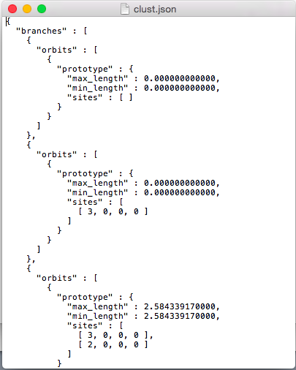
The clust.json file
Lists one example (“prototype”) of each cluster type

Slide 81
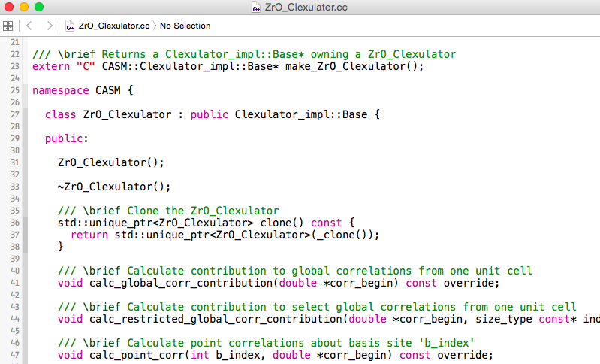
The clexulator (ZrO_Clexulator.cc)
Generated code for evaluating basis functions
Generated code for evaluating basis functions

Slide 82
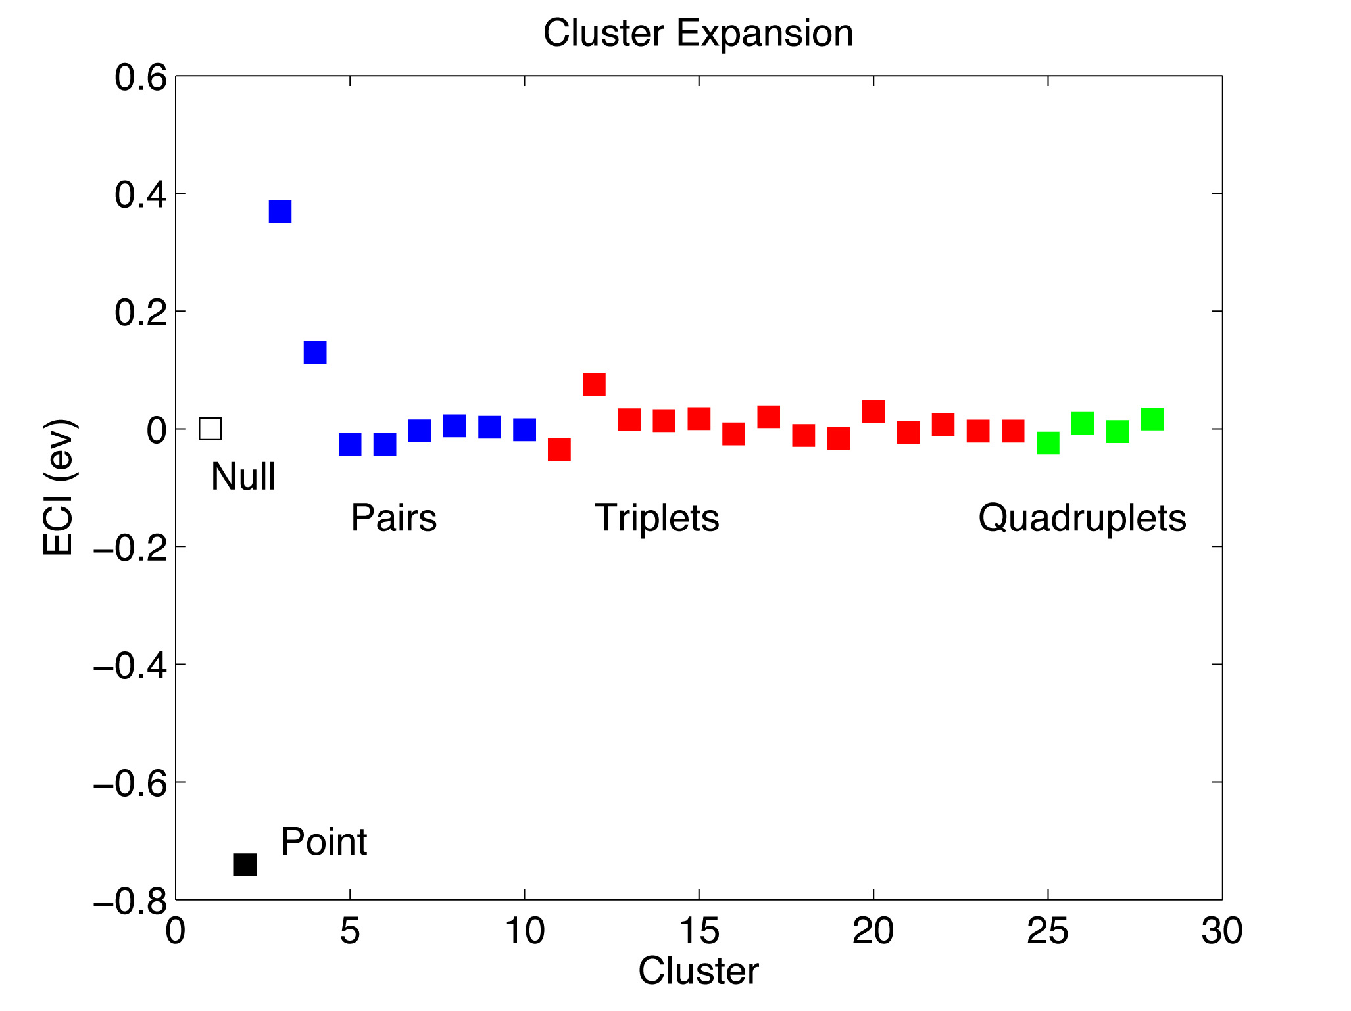
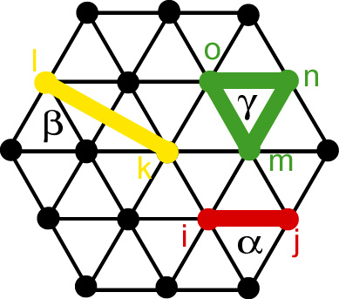
Cluster expansion for hcp Zr-O

Slide 83
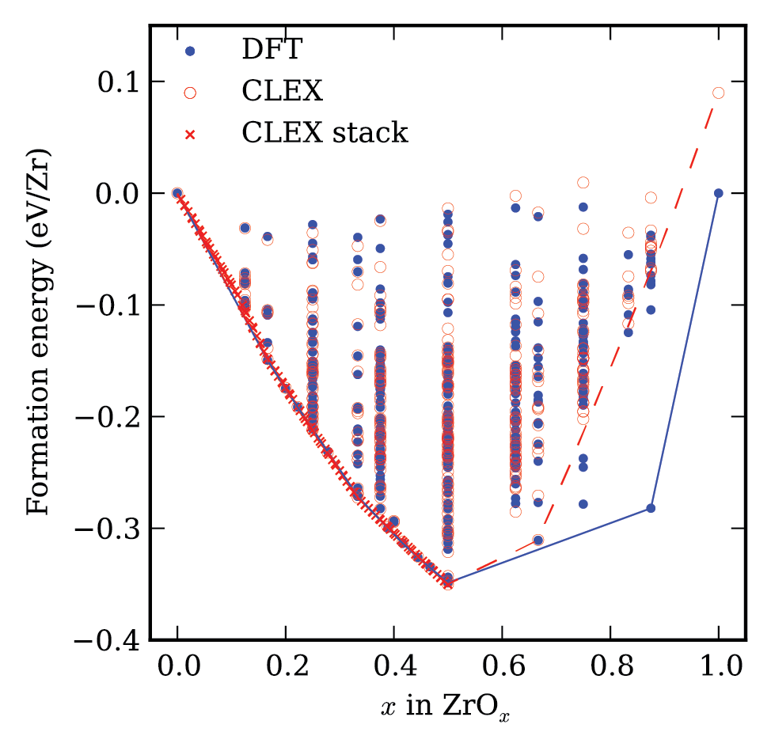
Cluster expansion for hcp Zr-O
Puchala and Van der Ven, Phys. Rev. B 88 094108 (2013).

Slide 84
CASM: Clusters Approach to Statistical Mechanics
First-principles energies of a “few” excitations
Extrapolate to
all other excitations
Lattice Model Hamiltonian
Monte Carlo
Thermodynamics

Slide 85
Summary
Crystal structure identification & specification
Symmetry analysis
Using CASM to manage data
Configuration selections and query syntax
Maintaining sanity with cluster expansion profiles
Cluster expansion basics
Configuration enumeration
Cluster expansion basis sets & correlation evaluation
After break:
Parameterizing cluster expansions
Predicting thermodynamic properties with grand canonical Monte Carlo
Free energy integration and phase diagram construction

